Slide 1
Chapter 12
Maintenance of Genomic Integrity and the Development of Cancer
Dec 8, 2023

Slide 2
Outline of this lecture
Tissue mechanisms for preventing the accumulation of mutations
Various types/origins of DNA alterations
Internal origin: DNA replication, metabolism etc.
External origin: physical and chemical agents
Small scale: point mutations
Large scale: Copy number alterations and chromosomal defects
DNA repair mechanisms
Single strand lesion repair：Mismatch Repair; Base excision repair; Nucleotide excision repair
Double strand break repair: Homologous recombination repair; Non-homologous end joining
Genome maintenance and cancer therapy
HRD and PARP inhibitor sensitivity

Slide 3
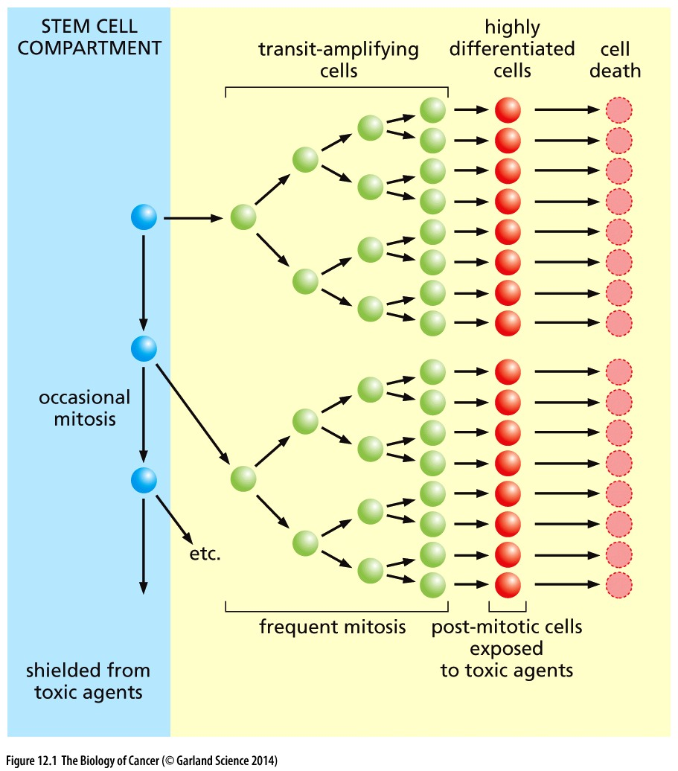
12.1 Tissues are organized to minimize the progressive accumulation of mutations
Figure 12.1 Tissue organization and
protection of the stem cell genome

Slide 4
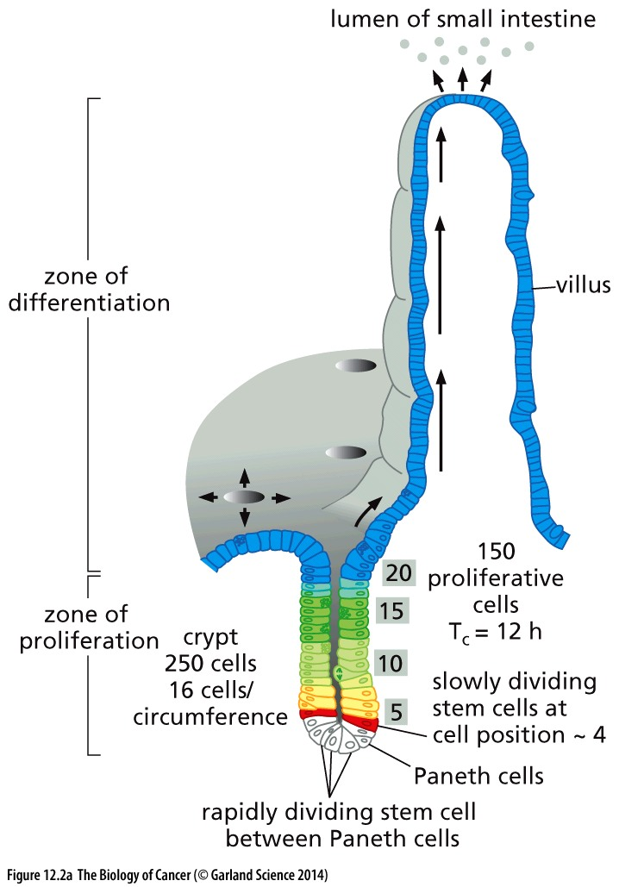
Figure 12.2 Stem cells and the organization of gastrointestinal crypts
(A) Boxed numbers indicate the position of individual enterocytes counting from the bottom of the crypt. The stem cells spawn a large number (~150) of highly proliferative transit-amplifying cells (yellow, green), which divide every 12 hours or so. Their division eventually yields approximately 3500 enterocytes (blue), which cover the finger-like villus. The enterocytes are continuously migrating toward the tip of the villus, where they undergo apoptosis and are shed into the lumen of the small intestine (light blue).

Slide 5
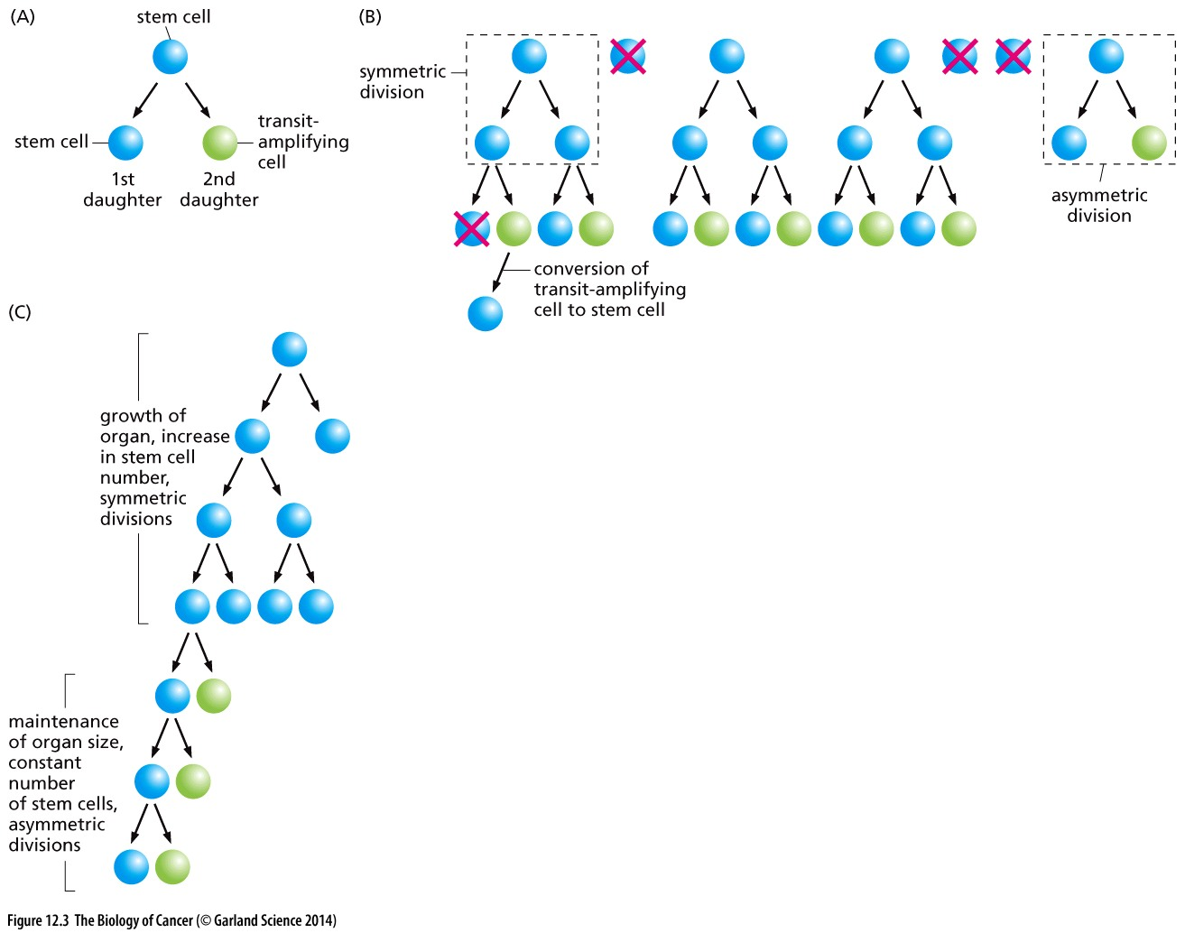
Figure 12.3 Asymmetric and symmetric divisions of stem cells (A) In general, during normal tissue function, it appears that a stem cell will usually divide asymmetrically, with one of its daughters remaining a stem cell (blue) while the other (green) proceeds to spawn a flock of transit-amplifying cells (not shown; see Figure 12.1). (B) In the event that several stem cells in a tissue are lost, some of the surviving stem cells may divide symmetrically in order to re-populate the stem cell pool. (C) Similarly, when an organ is growing, the number of stem cells must increase proportionately, requiring some stem cells to undergo symmetric divisions.

Slide 6
12.4 Cell genomes are threatened by errors made during DNA replication
The basic replication machinery in the cell nucleus is powered by the actions of three polymerases, pol-α, pol-δ, and pol-ε. (In all, 19 distinct DNA polymerase genes have been cataloged in the human genome, and more are likely to be found; as will be apparent later, most of these are not involved in DNA replication per se but rather in the repair of damaged DNA molecules.)

Slide 7
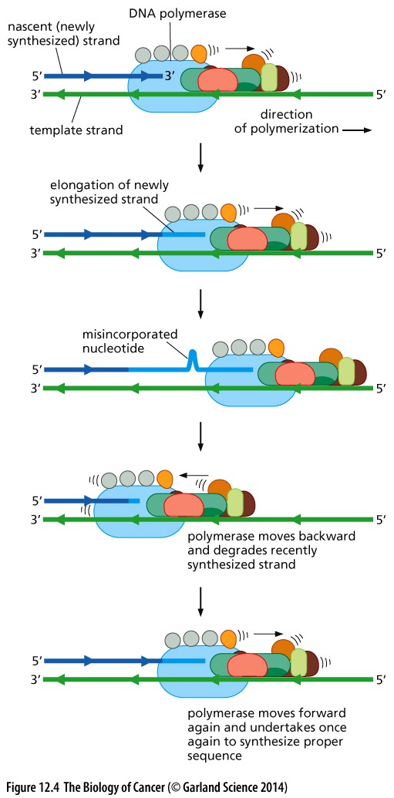
Figure 12.4 Proofreading by DNA
polymerases
A number of DNA polymerases have a proofreading ability that allows them to minimize the number of bases that are misincorporated and retained in the recently synthesized strand.
DNA polymerases such as pol-δ continuously look backward, “over their shoulder,” scanning the stretch of DNA that they have just polymerized; such monitoring is often called proofreading.

Slide 8
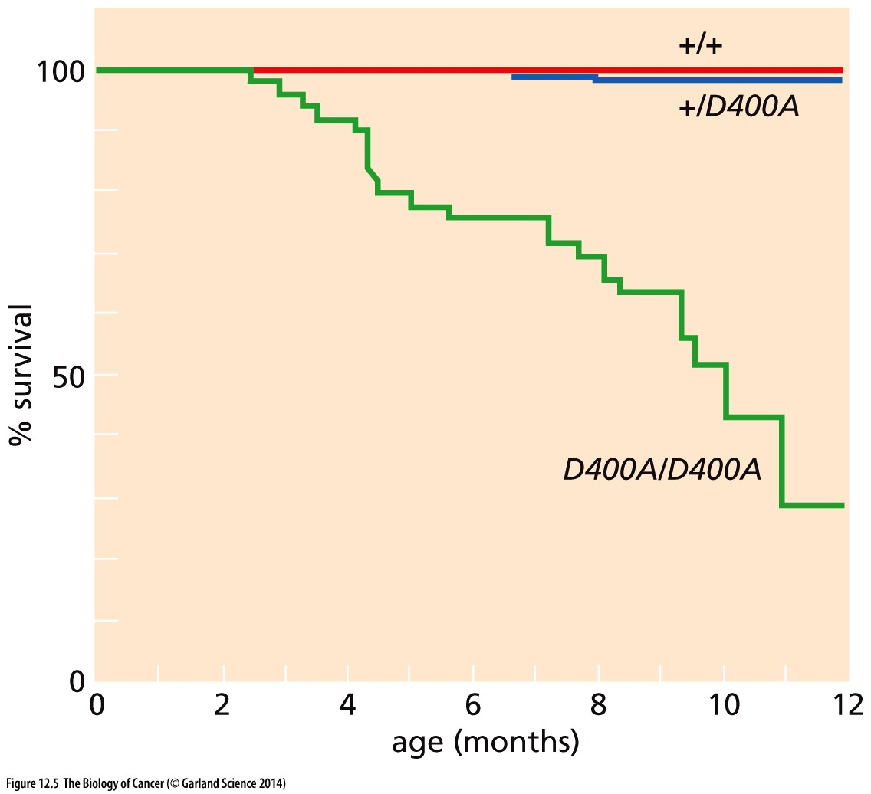
Figure 12.5 Proofreading by DNA polymerase and cancer incidence
Similar to the cancers induced by mutagens.

Slide 9
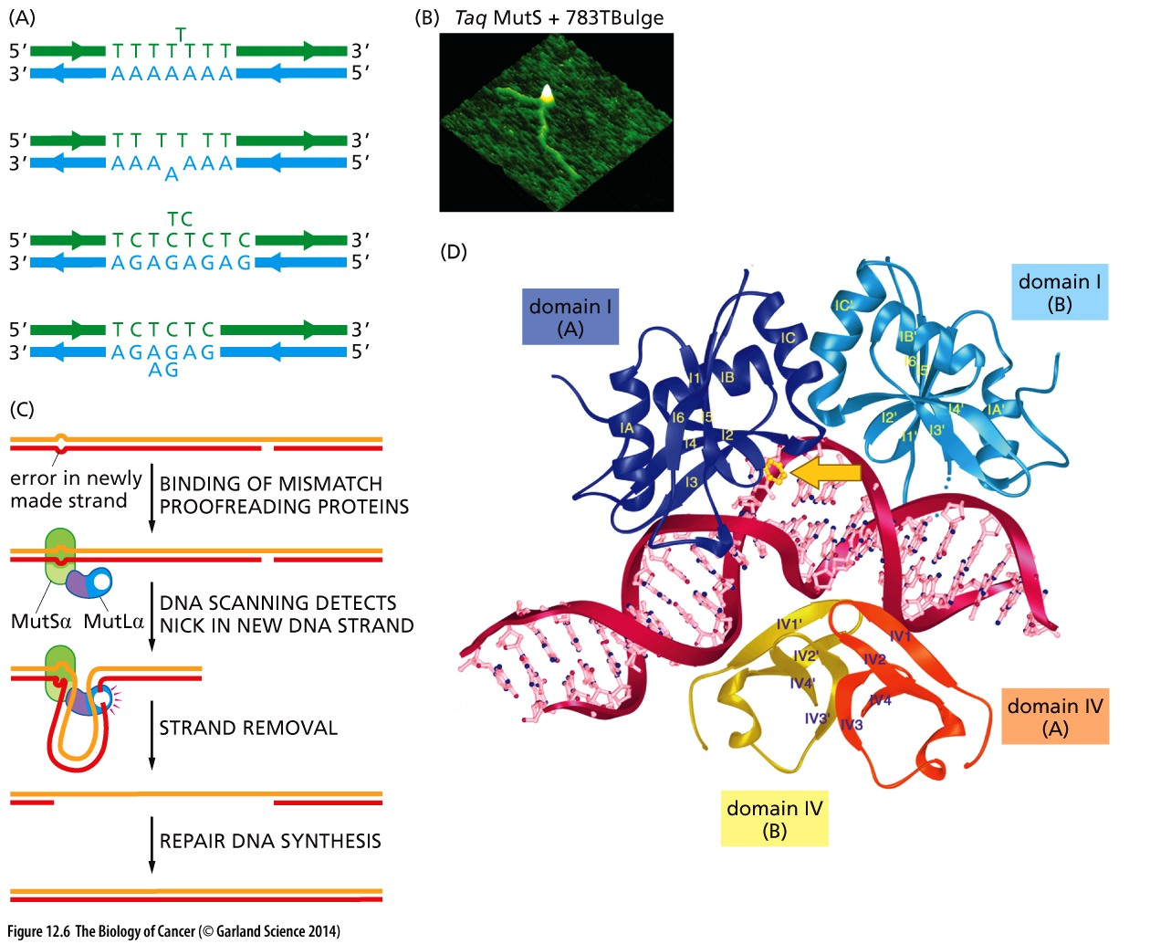
Figure 12.6 DNA polymerase errors and mismatch repair
Mismatch repair is done right after the replication process ends

Slide 10
highly repeated sequences in the genome, often carrying 100 or more nucleotides per repeat unit, have been called “satellite” sequences. Because the simple, far shorter sequences discussed here are also found in many places in the genome, they have been named microsatellites. A defective mismatch repair system that fails to detect and remove stuttering mistakes made by DNA polymerases when copying a microsatellite will result in the expansion or shrinkage of its sequences in progeny cells. This creates the genetic condition known as microsatellite instability (MIN; Figure 12.7A),
Mismatch repair defect → microsatellite instability
Notes:
卫星DNA名称来由：密度梯度离心，密度不一样，环绕主条带的卫星条带

Slide 11
MSI and colon cancer
Microsatellite instability (MSI) is the condition of genetic hypermutability that results from impaired DNA mismatch repair (MMR).
Microsatellite instability (MSI) is a hypermutable phenotype caused by the loss of DNA mismatch repair activity. MSI is detected in about 15% of all colorectal cancers; 3% are of these are associated with Lynch syndrome and the other 12% are caused by sporadic, acquired hypermethylation of the promoter of theMLH1 gene, which occurs in tumors with the CpG island methylator phenotype.

Slide 12
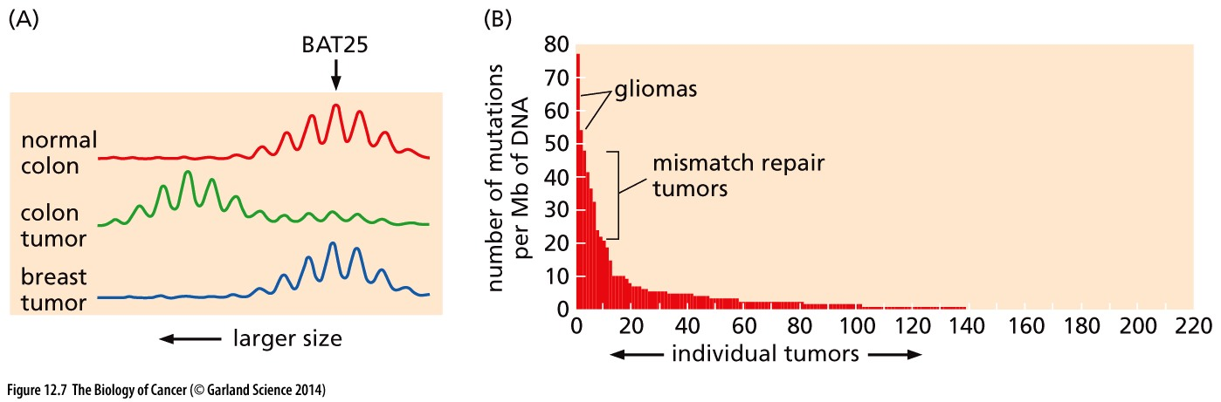
Figure 12.7 Detection of microsatellite instability
Notes:
In the analysis shown here, the size of a mononucleotide repeat is analyzed in a woman suffering from HNPCC (hereditary non-polyposis colon cancer) and presenting in the clinic with both a colorectal and a breast carcinoma; analysis was performed using PCR (polymerase chain reaction). The BAT25 sequence, which is located on human Chromosome 4q12, consists of the sequence TTTTxTxTTTTxT7xxT25, where “x” indicates a nucleotide other than T. Because of errors made by the polymerase used in the PCR reaction, the products of the PCR reactions show a Gaussian distribution of lengths grouped around the actual length of the genomic DNA segment being amplified. This analysis reveals a clear increase in size of the microsatellite repeat in the colon carcinoma (leftward shift), while the breast tumor exhibits a microsatellite repeat that is precisely the same as normal, control DNA. (This observation strongly suggests that the breast carcinoma, unlike the colon carcinoma, is unlikely to have been caused by MIN.)

Slide 13
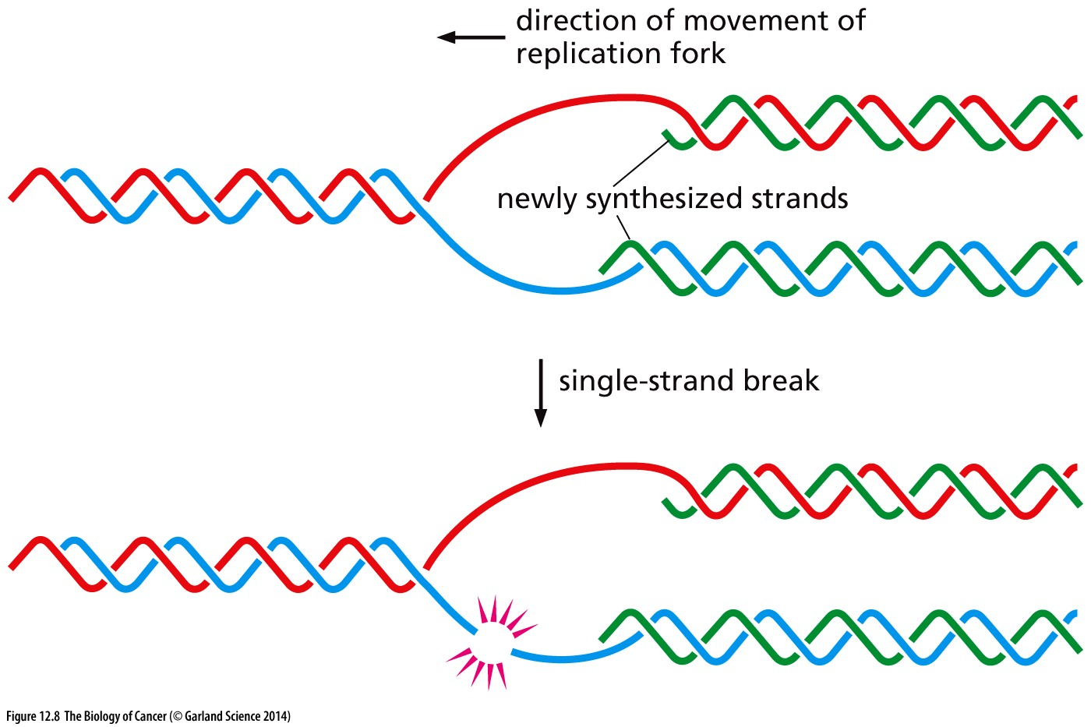
Figure 12.8 Double-strand DNA breaks at replication forks
During DNA replication, the DNA molecules
are especially vulnerable to breakage in the single-stranded portions near the replication fork that have not yet undergone replication. Such breaks often occur because of the chemical alteration of a base that causes the DNA polymerase to stall, being unable to recognize this altered base; The breakage of such a single-stranded region (sometimes termed a “collapsed” replication fork) is functionally equivalent to a doublestrand break occurring in an already formed double helix, in that the break leaves two helices unconnected by either strand.

Slide 14
12.5 Cell genomes are under constant attack from endogenous biochemical processes

Slide 15
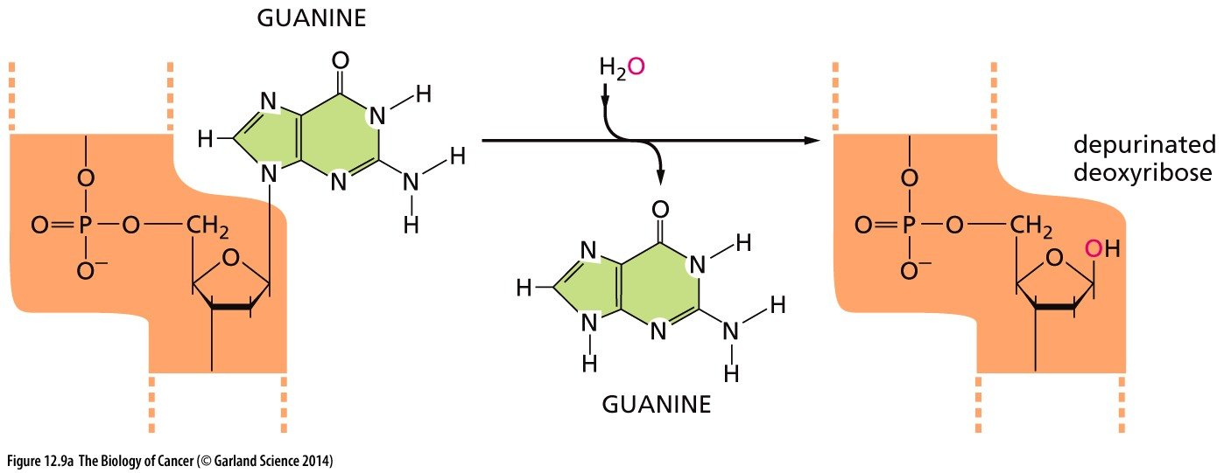
Figure 12.9 Depurination
(A) Spontaneous depurination frequently affects guanine within DNA, leaving behind a deoxyribose.

Slide 16
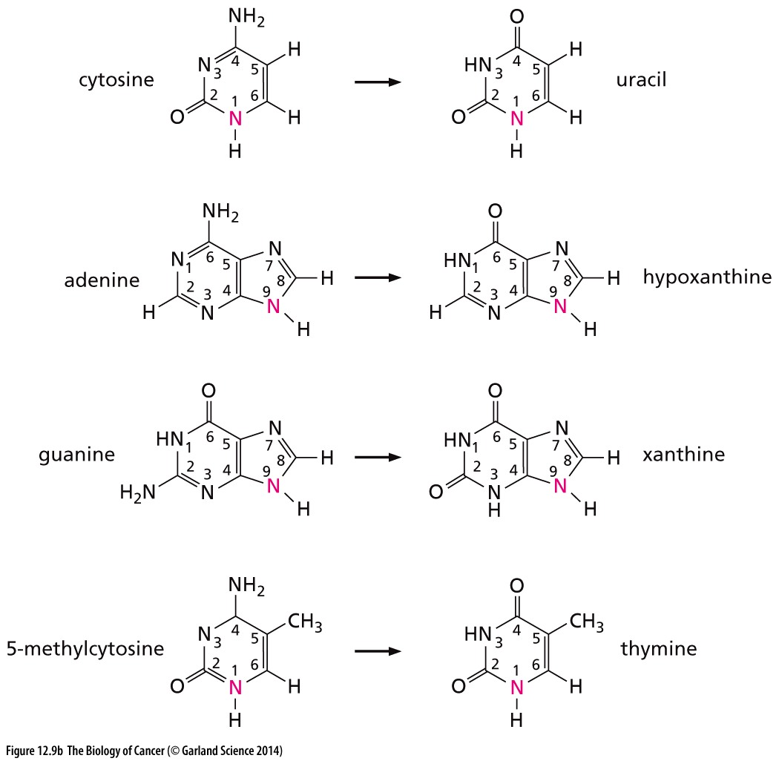
Base deamination
胞嘧啶
尿嘧啶
(B) The deamination reactions
affecting purine and pyrimidine bases, which occur spontaneously at various rates at neutral pH, lead to changes in nucleotide sequences unless they are repaired. The deamination of 5-methylcytosine yields thymine (bottom); because this base is naturally present in DNA, it is not always recognized as being aberrant by the repair machinery, explaining the frequent mutations at sites bearing this methylated base. (In each case, the nitrogen atom in red participates in the formation of a glycosidic bond with the 1-carbon of deoxyribose.)
腺嘌呤
鸟嘌呤
胸腺嘧啶
Notes:
衰老相关DNA变异模式

Slide 17
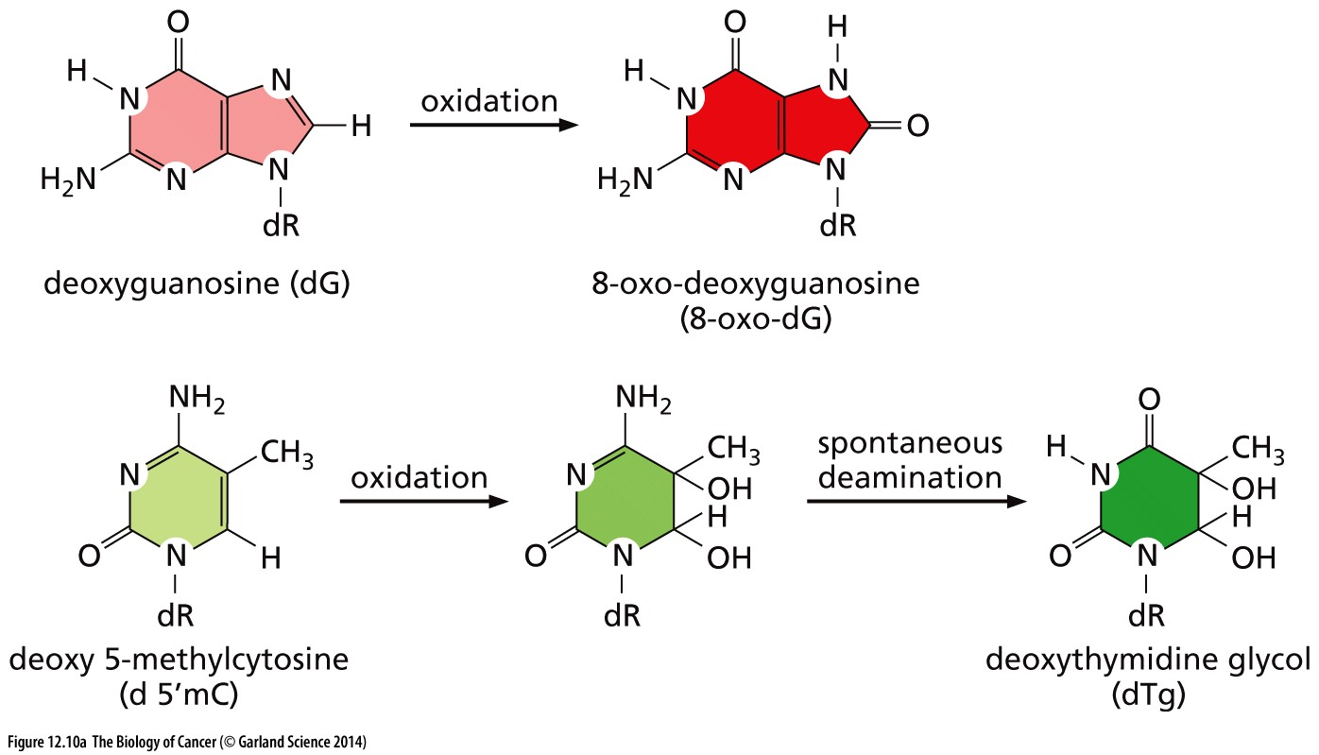
Figure 12.10 Oxidation of bases in the DNA
The oxidation of DNA bases, which often results from the actions of reactive oxygen species (ROS), can be mutagenic in the absence of subsequent DNA repair reactions. (A) Two frequent oxidation reactions involve deoxyguanosine (dG), which is oxidized to 8-oxo-deoxyguanosine (8-oxo-dG); and deoxy-5-methylcytosine (d5mC), the nucleotide that is present in methylated CpG sequences. Upon oxidation, the latter initially forms an unstable base that rapidly deaminates, yielding deoxythymidine glycol (dTg).

Slide 18
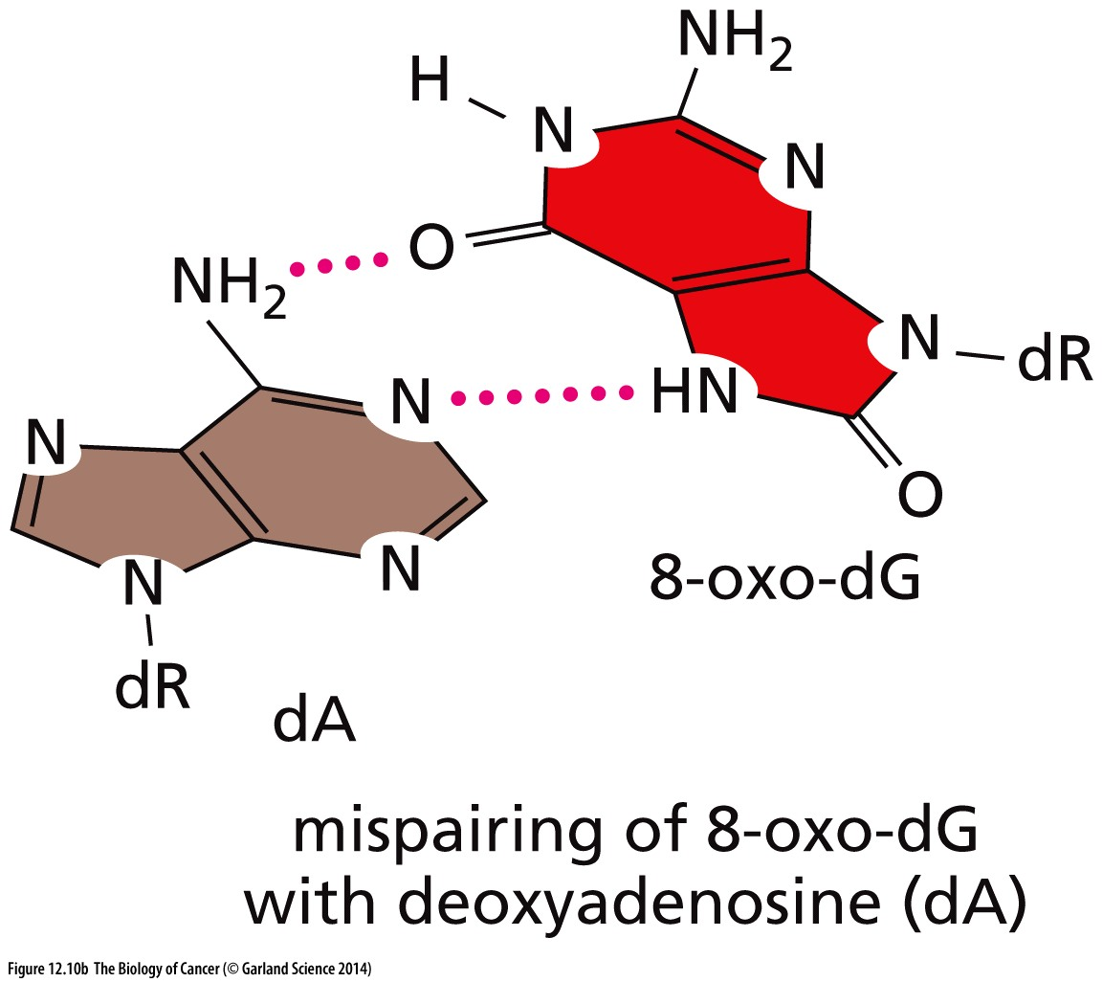
(B) The 8-oxo-dG, which is formed by the oxidation of dG, can mispair with deoxyadenosine (dA) rather than forming a normal base pair with deoxycytosine (dC). Hence, if 8-oxo-dG is not removed from a double helix, the DNA replication machinery may inappropriately incorporate a dA rather than a dC opposite it, resulting in a C–A point mutation. “dR” signifies deoxyribose in all cases. The purines are shown in various shades of red and brown, while the pyrimidines are shown in various shades of green.

Slide 19
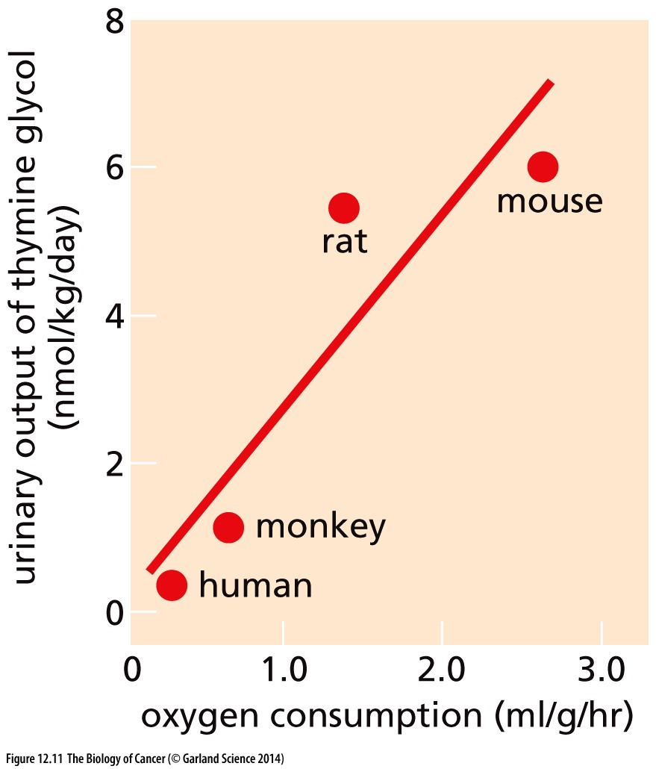
Figure 12.11 Metabolic rate and DNA oxidation

Slide 20
12.6 Cell genomes are under occasional attack from exogenous mutagens and their metabolites

Slide 21
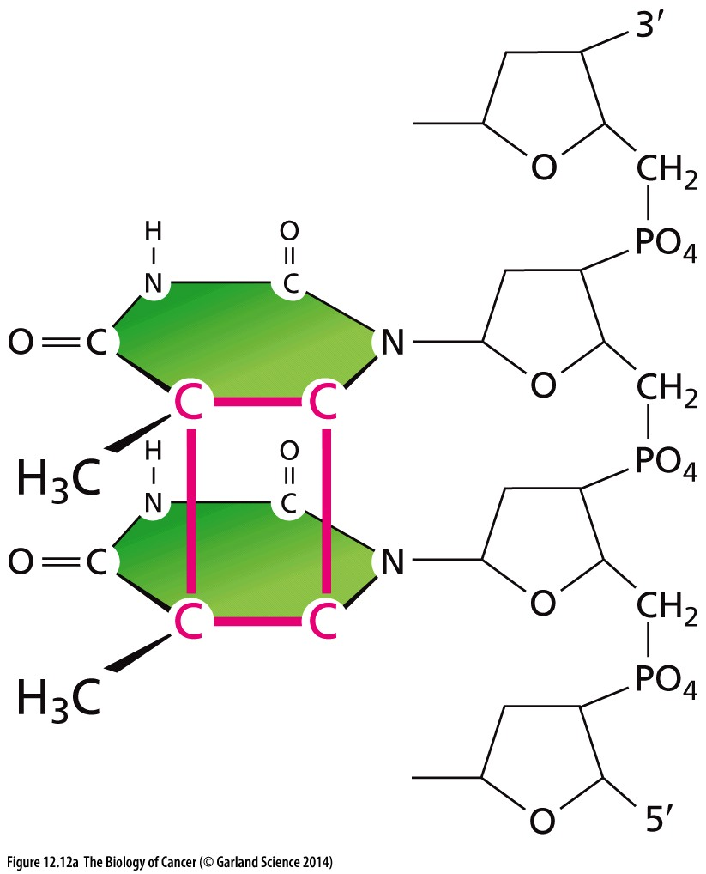
Figure 12.12 Products of UV irradiation
Ultraviolet (UV) radiation produces covalent cross-links between adjacent pyrimidine bases in the DNA. When purified DNA is irradiated with 254-nm photons, 71% of the photoproducts are the cyclobutane pyrimidine dimers (CPD; A), while 24% are the pyrimidine (6-4) pyrimidinone (6-4 PP) photoproducts

Slide 22
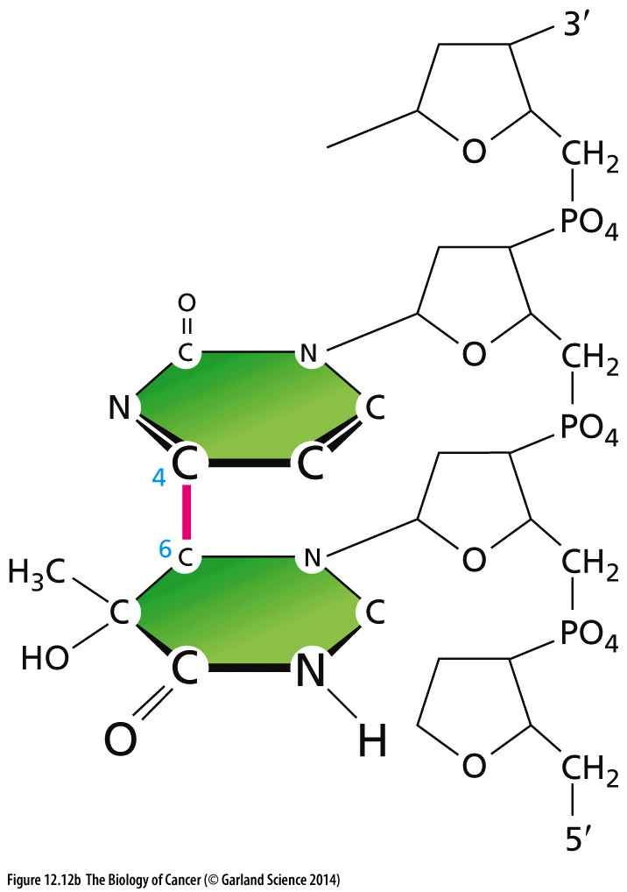
Figure 12.12 Products of UV irradiation
(B). The cyclobutane ring of a CPD
is highlighted in red in panel A, as
is the bond linking the 6-position of
one pyrimidine to the 4-position of
the adjacent pyrimidine in panel B.
These structures are relatively stable
chemically and must be removed by
transcription-coupled repair and global
genomic repair (described in Section
12.8).

Slide 23
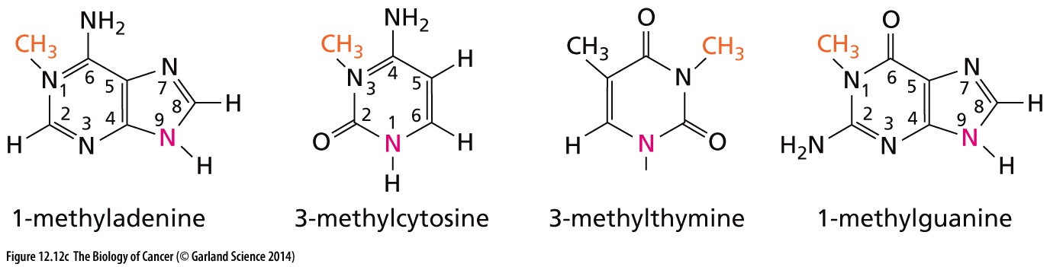
Figure 12.12 Products of alkylation of DNA
(C) Exogenous alkylating agents can covalently alter DNA bases by the attachment of alkyl groups, such as the methyl groups (orange) shown here. Many of these methyl groups may also be generated endogenously by the inadvertent actions of S-adenosyl methionine, which carries a highly reactive methyl that plays a key role in many normal biosynthetic reactions. The nitrogens that form glycosidic linkages with deoxyribose are shown in pink.

Slide 24
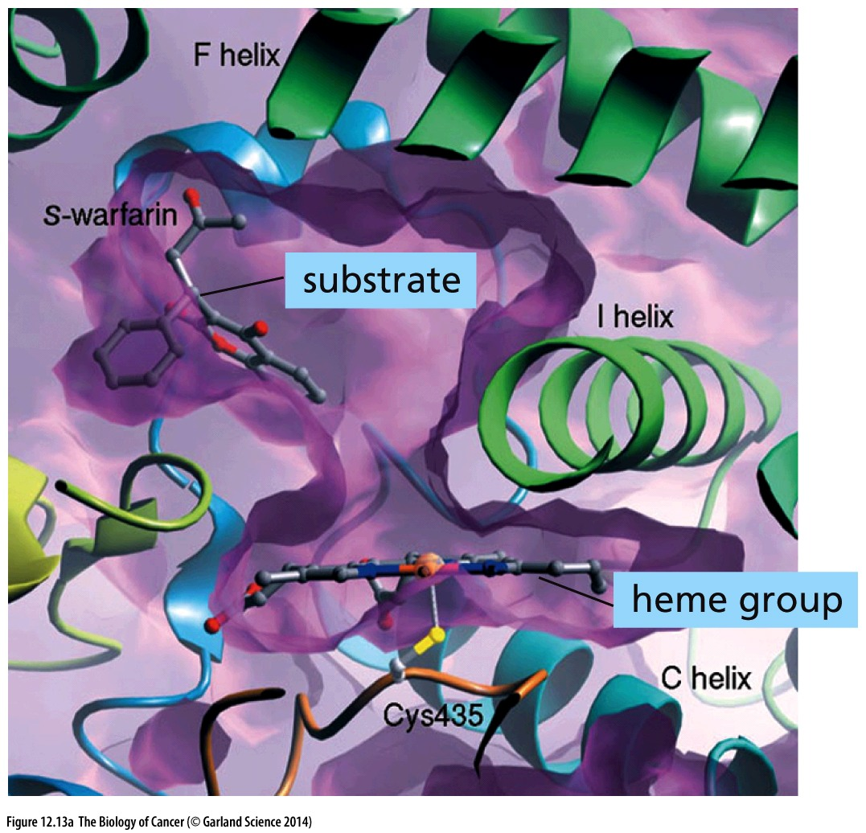
Figure 12.13 Actions of cytochromes on procarcinogens
(A) Cytochrome（细胞色素）P450s (CYPs) are involved in the biosynthesis of a variety of metabolites such as steroid hormones, cholesterol, and bile acids as well as the degradation of compounds such as fatty acids and steroids. In addition, they aid in the oxidation and associated detoxification of xenobiotics (compounds originating outside the body), such as drugs and carcinogens. The substrate-binding cavity of human CYP2C9, shown here, carries a molecule of a xenobiotic substrate, in this case warfarin (used both as an anticoagulant drug and as a rat poison).

Slide 25
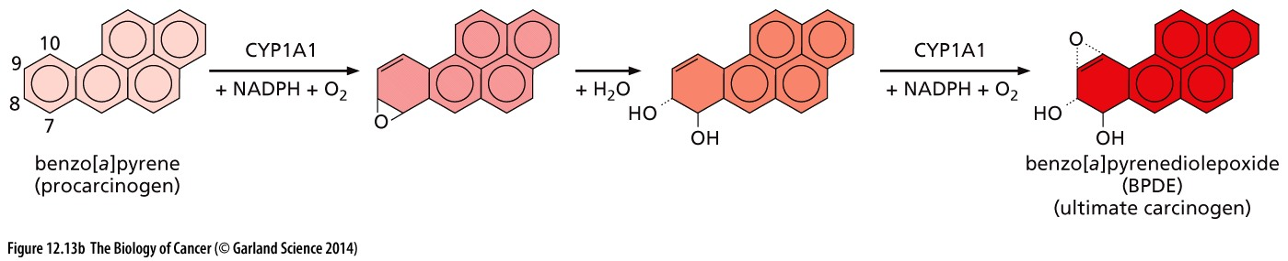
Figure 12.13 Actions of cytochromes on procarcinogens
(B) Among the xenobiotic（外源化合物）compounds entering the body are a variety of polycyclic aromatic hydrocarbons (PAHs) that derive from tobacco smoke, broiled foods, and polluted environments. A common PAH is benzo[a]pyrene (BP, far left), which, following two successive oxidation reactions mediated by cytochrome P450 enzymes (largely CYP1A1), is converted to benzo[a] pyrenediolepoxide (BPDE; far right). This highly reactive molecule is termed an ultimate carcinogen (Section 2.10) because, unlike its BP precursor, it is able to directly attack and form covalent adducts with DNA bases, which may then generate oncogenic mutations.

Slide 26
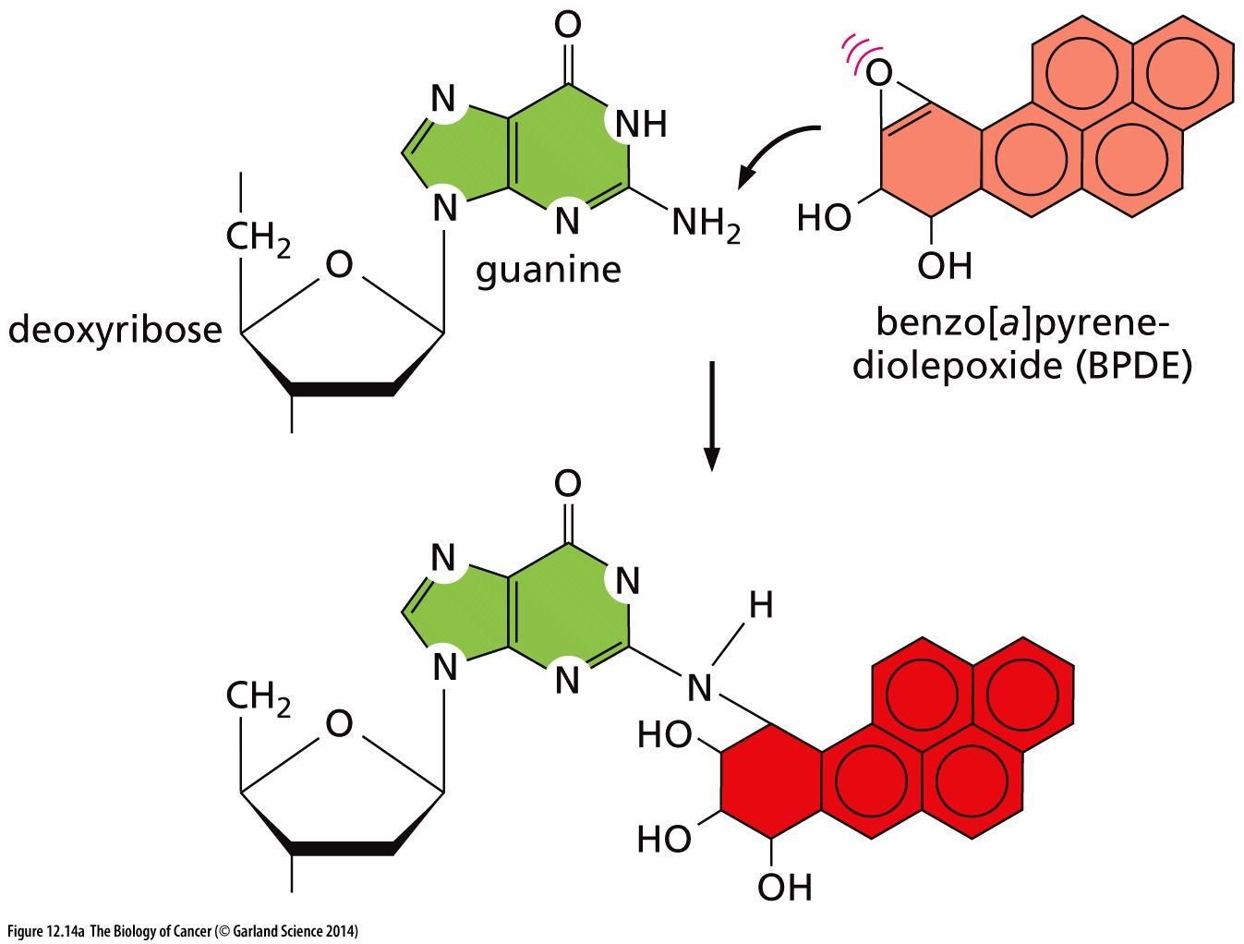
Figure 12.14 DNA adducts
(A) The chemically reactive epoxide group of benzo[a]pyrenediolepoxide (BPDE; see Figure 12.13B) can attack a number of chemical sites in DNA, including the extracyclic amine of guanine (shown here). Even though polycyclic aromatic hydrocarbons and BP have been studied for more than half a century, their precise contributions to human cancer development remain a matter of debate, although indirect evidence provides strong suggestion of an important role (see Figure 12.15).

Slide 27
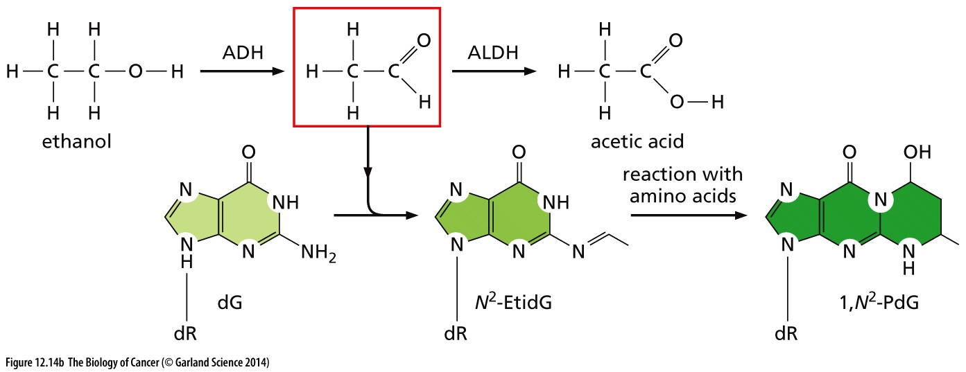
Figure 12.14 DNA adducts
(B) Ethanol, which is consumed in large quantities by many people, is converted by alcohol dehydrogenase (ADH) to acetaldehyde (red box), which has been classified as a mutagen because of its reactivity with DNA. Heavy drinkers with inborn alleles leading to either highly active ADH or slow acetaldehyde breakdown (via aldehyde dehydrogenase, ALDH) exhibit an especially elevated risk of developing oral and esophageal carcinomas.

Slide 28
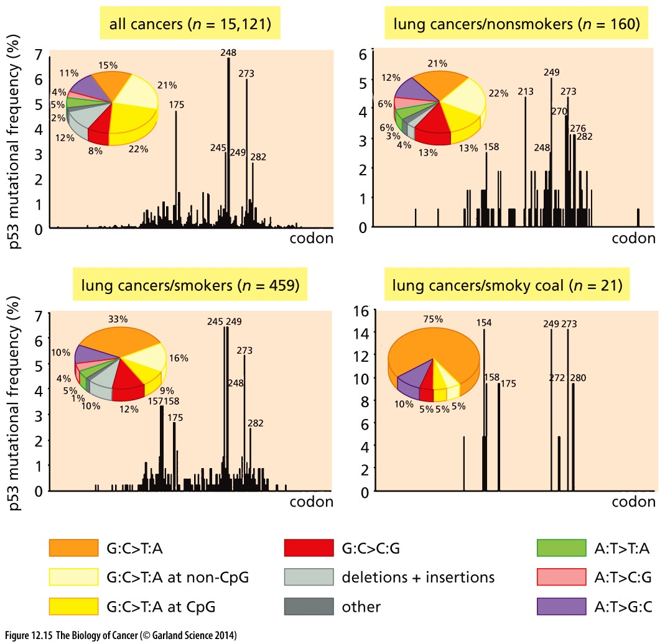
Figure 12.15 p53 point mutations caused by mutagens
Notes:
现代的变异原因分析方法：mutational signature analysis

Slide 29
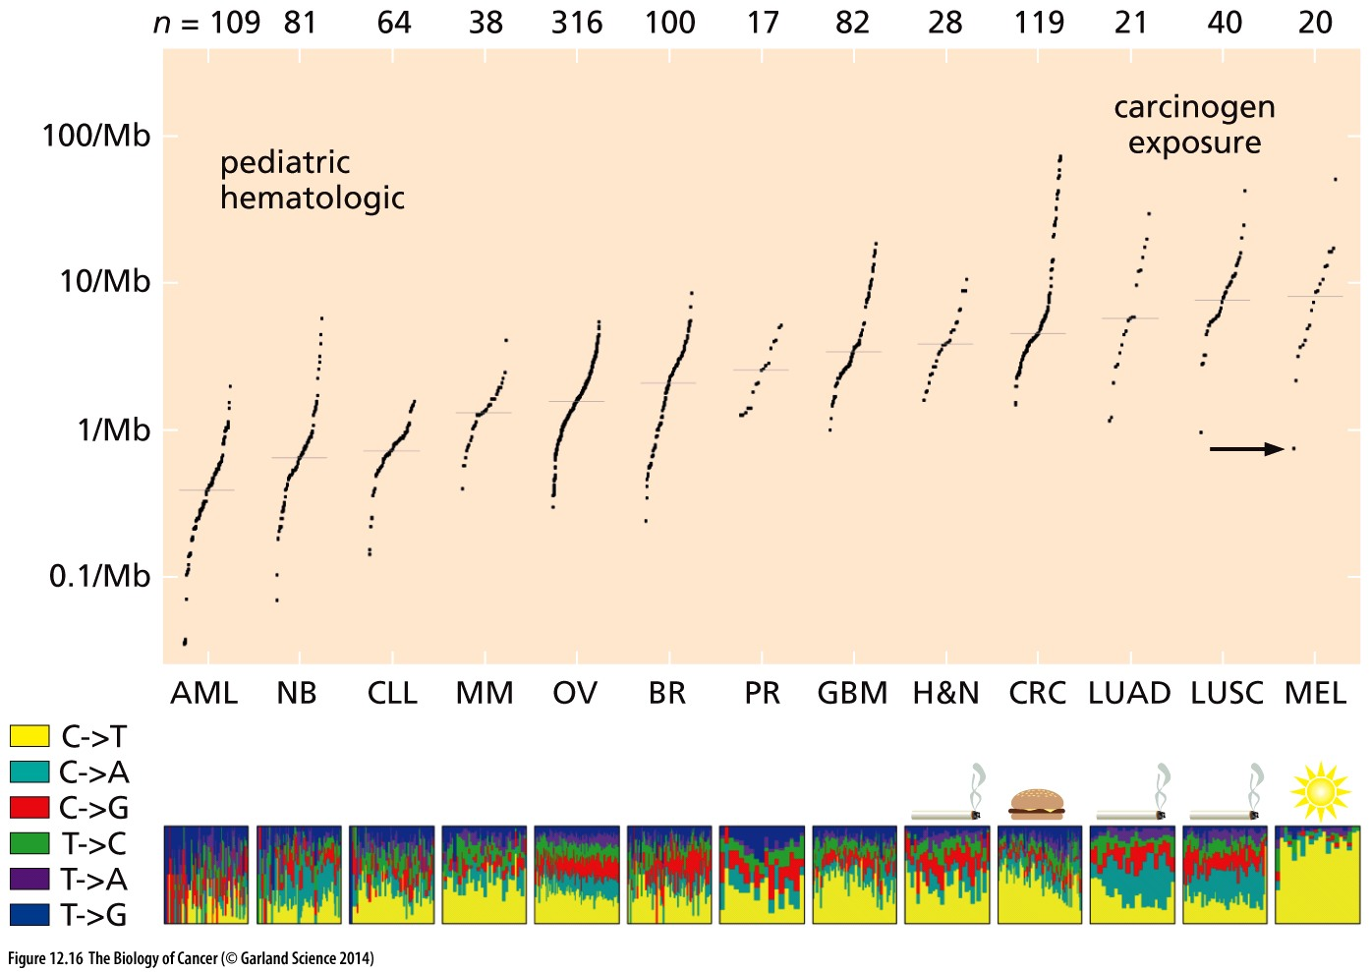
Figure 12.16 Large-scale genome sequencing reveals diverse patterns of mutagenesis
AML, acute myelogenous leukemia;
NB, neuroblastoma;
CLL, chronic lymphocytic leukemia;
MM, multiple myeloma;
OV, ovarian carcinoma;
BR, breast ca.,
PR, prostate carcinoma;
GBM, glioblastoma multiforme;
H&N,head-and-neck squamous cell carcinoma;
CRC, colorectal carcinoma;
LUAD, lung adenocarcinoma;
LUSC, lung squamous cell carcinoma;
MEL, melanoma.

Slide 30
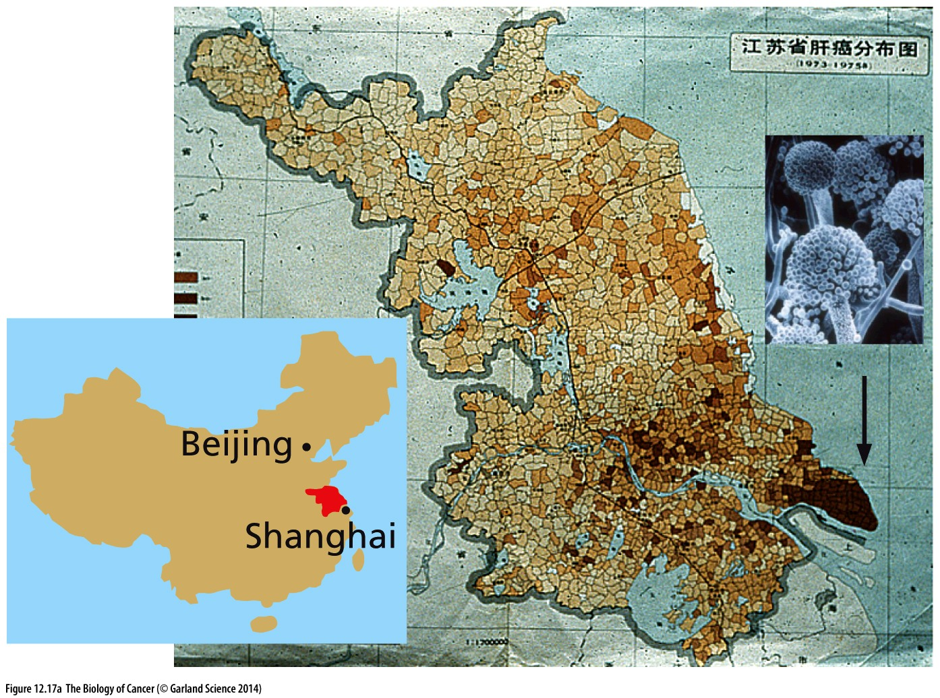
Figure 12.17 Aflatoxin （黄曲霉素）and liver carcinogenesis
(A) The fungal toxin aflatoxin B1 (AFB1) is made by molds, largely Aspergillus flavus (inset), that grow on peanuts and grains that have been stored improperly, notably in areas of high rainfall and humidity; it is one of the most potently mutagenic substances known (see Figure 2.28). Within the Jiangsu province of eastern China, the incidence of hepatocellular carcinoma (HCC) cases (brown dots) is 8-fold higher in the very humid southeastern Qidong peninsula (arrow) than in the northwestern parts of the province. The incidence of hepatitis B virus (HBV) infection—a critical co-carcinogen in HCC pathogenesis (see Section 11.15)—is relatively constant across the province.

Slide 31
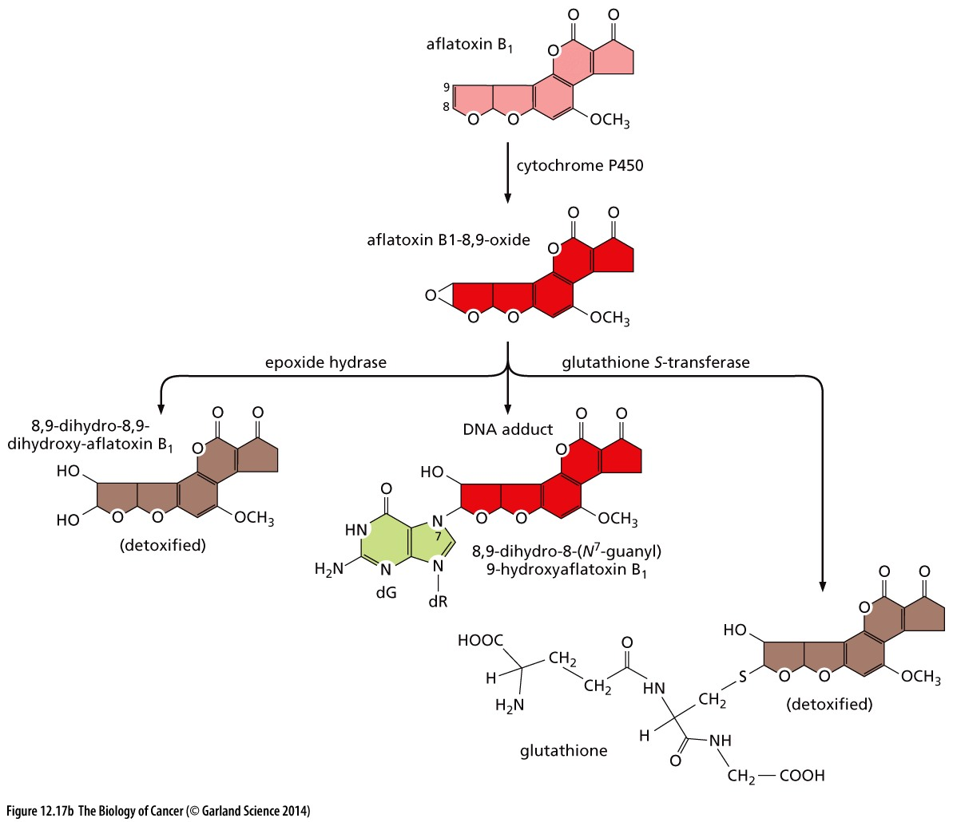
Figure 12.17 Aflatoxin （黄曲霉素）and liver carcinogenesis
(B) Activation of AFB1 (pink) by cytochrome P450s results in formation of the highly reactive 8,9-oxide form (red). This may be detoxified through several side reactions (bottom left, right), or it can react directly with DNA, forming a covalent adduct with the N7 atom of guanosine (light green) that is highly mutagenic. Indeed, the liver carcinomas of individuals living in areas of high AFB1 exposure often carry mutant p53 alleles with a characteristic G-to-T transversion in codon 249—precisely the type of mutation that would be expected from the known reactivity of AFB1.

Slide 32
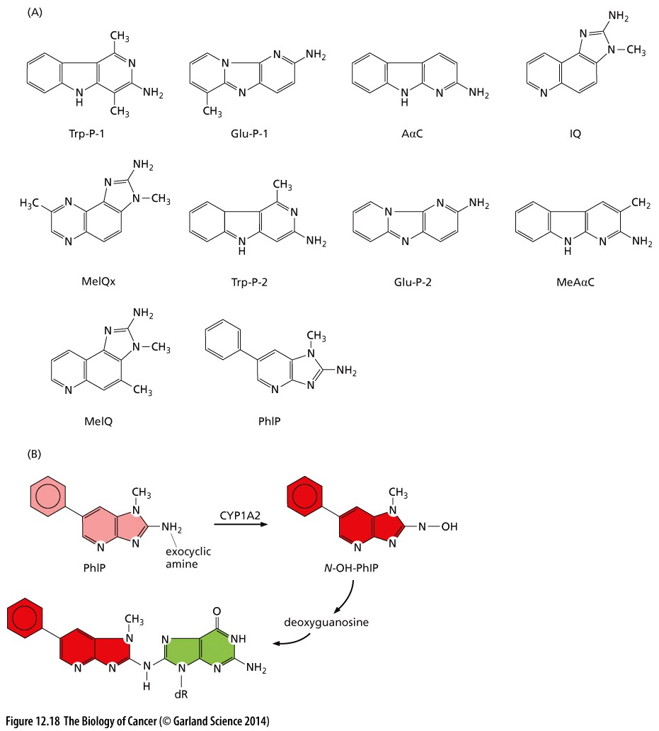
Figure 12.18 Heterocyclic amines（杂环胺）
(A) The 10 heterocyclic amines (HCAs) shown here are the most common HCAs to which humans are exposed. HCAs arise through cooking foods, notably red meats, at high temperature. PhIP has been estimated to constitute two thirds of the total dietary intake of HCAs among Americans. (B) The oxidation of the exocyclic amine of PhIP (2-amino-1-methyl-6- phenylimidazo[4,5-b]pyridine; pink) by CYP1A2, a cytochrome P450, leads to the highly reactive compound N-OH-PhIP (red). It can react with the 8-C of deoxyguanosine (green) to form a mutagenic adduct (lower left).

Slide 33
12.7 Cells deploy a variety of defenses to protect DNA molecules from attack by mutagens

Slide 34
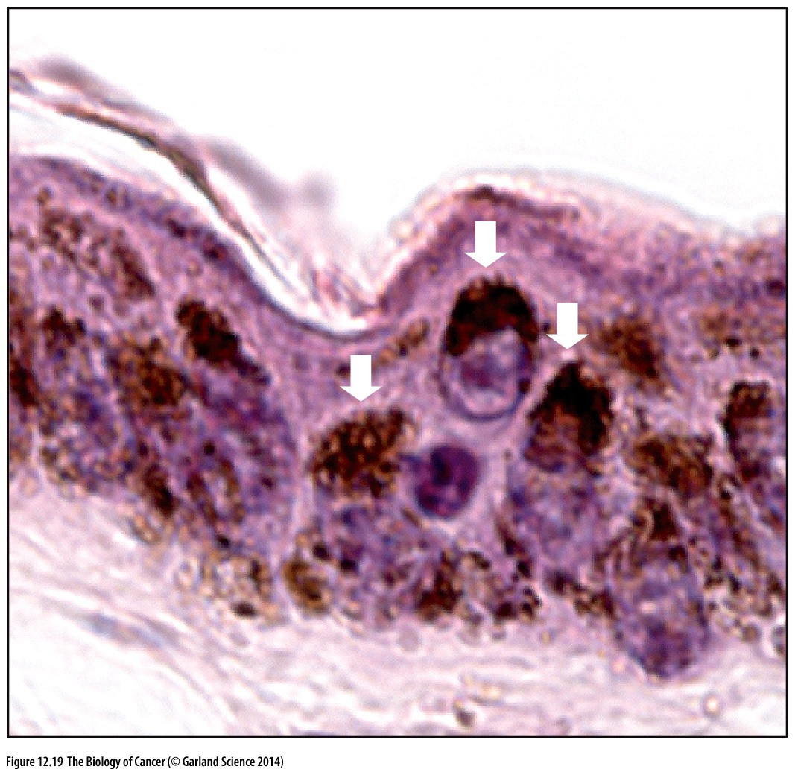
Figure 12.19 Physical shielding of keratinocyte nuclei from ultraviolet radiation
Black people have much less rate of melanoma compared to white people

Slide 35
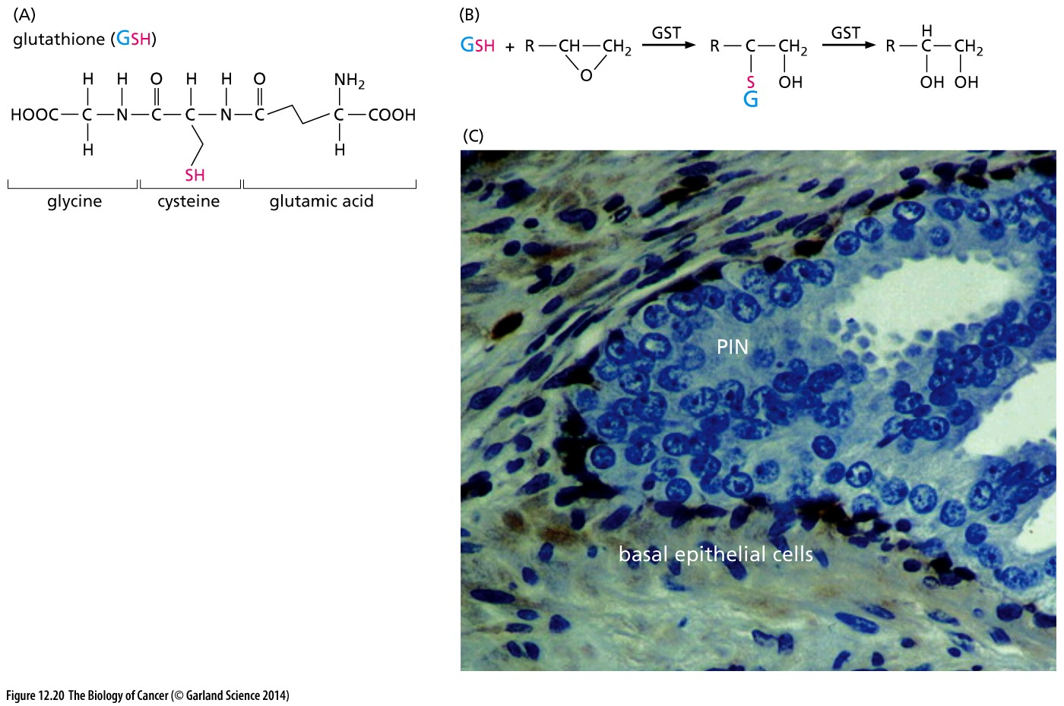
Figure 12.20 Glutathione S-transferase and its loss from tumors
(C) As many as 90% of prostate carcinomas show the loss of expression of an important glutathione S-transferase, GST-π; this deprives the tumor cells of the means to detoxify many electrophilic mutagens. In the premalignant PIN (prostatic intraepithelial neoplasia) lesion—a benign precursor of prostate carcinoma—shown here, use of an antibody reactive with GST-πdemonstrates the presence of GST-π in the basal epithelial cells (dark brown,left side), but loss of all GST-π expression in the luminal epithelial cells (light blue, right side).

Slide 36
12.8 Repair enzymes fix DNA that has been altered by mutagens

Slide 37
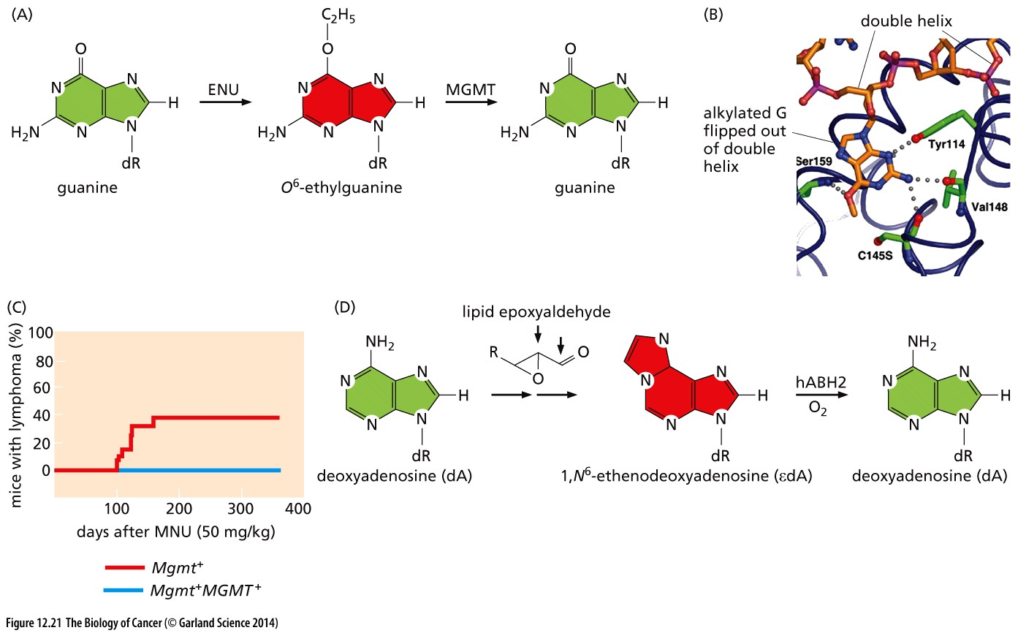
Figure 12.21 Restoration of normal base structure by dealkylating repair enzymes

Slide 38
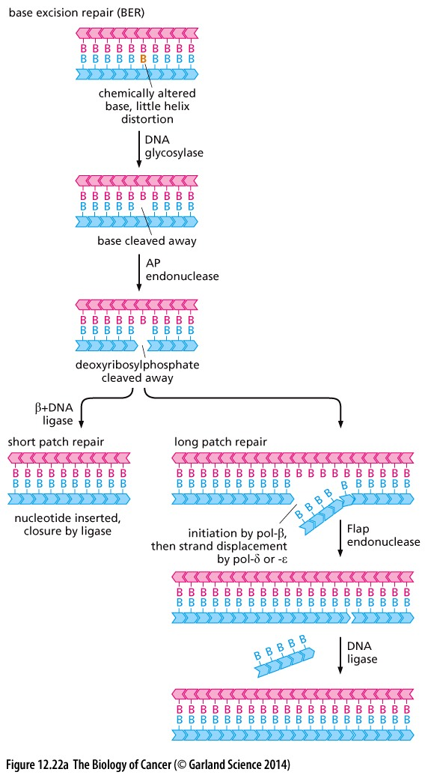
Figure 12.22 Base- and nucleotide-excision repair
(A) Base-excision repair (BER) is achieved by enzymes that recognize chemically altered bases having minimal helix-distorting effect.

Slide 39
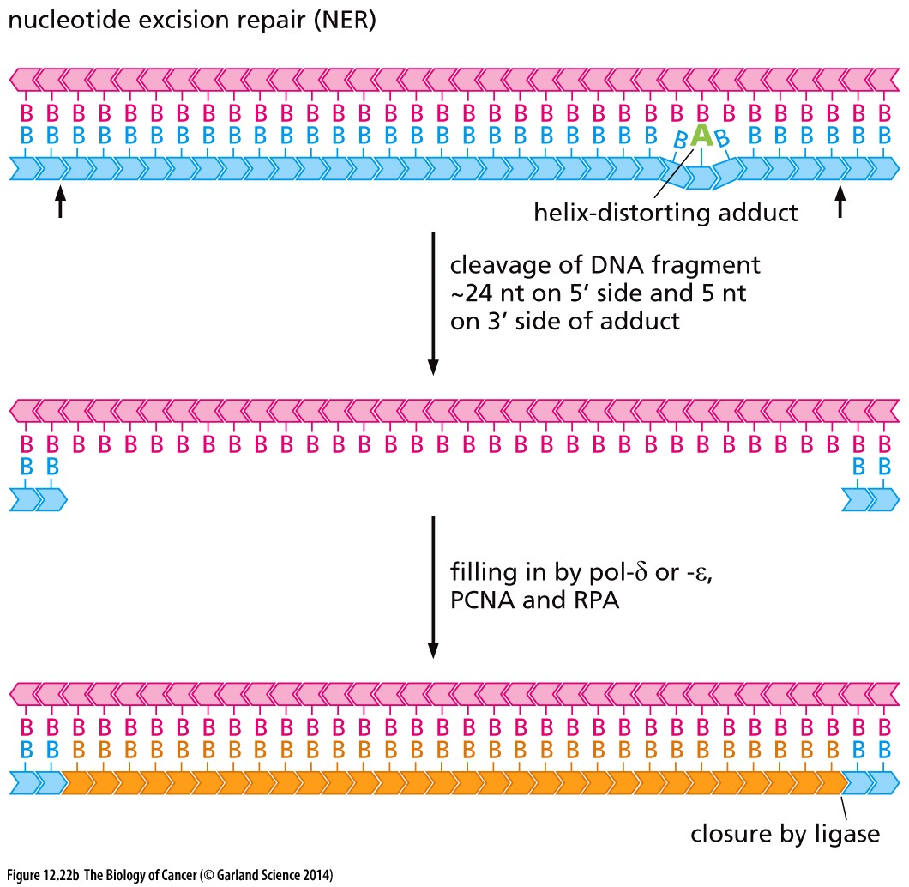
(B) Nucleotide-excision repair (NER) is accomplished by enzymes that recognize bulky, helix-distorting lesions and cleave the flanking oligonucleotide sequences at sites approximately 24 nucleotides (nt) on the 5ʹ side and about 5 nucleotides on the 3ʹ side. The resulting approximately 29-nt single-strand gap in the DNA is then filled by DNA polymerase δ or ε, acting together with PCNA (proliferating-cell nuclear antigen) and RPA (which binds to single-strand DNA), and is finally sealed by a DNA ligase.

Slide 40
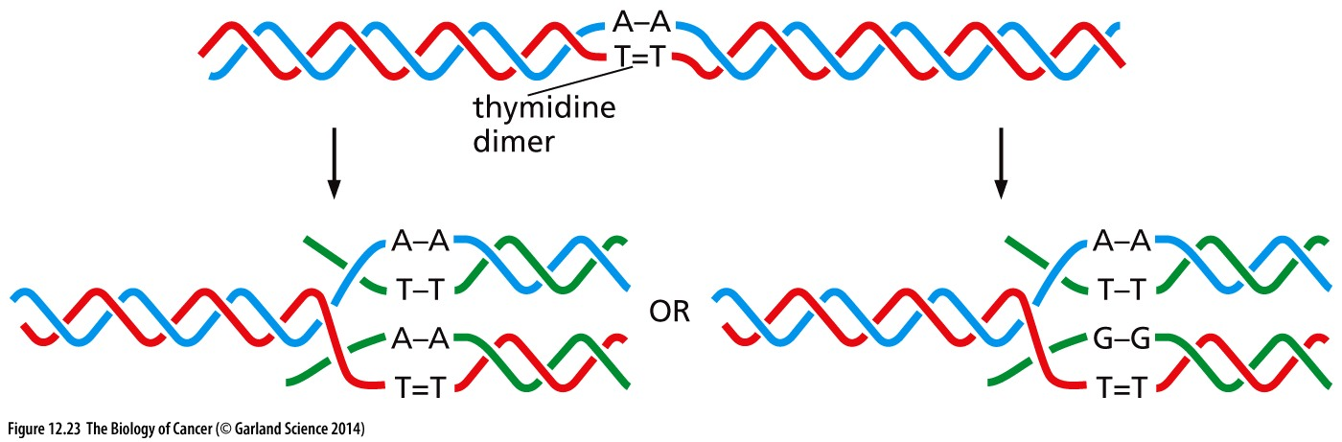
Figure 12.23 Error-prone repair
Error-prone DNA synthesis occurs when an advancing DNA replication fork encounters a still-unrepaired DNA lesion, such as the thymidine dimer shown here. In the great majority of cases (left), the error-prone DNA polymerase (sometimes called a bypass polymerase) responds to this lesion in the damaged template strand (red) by inserting the appropriate bases (in this instance, an A–A dinucleotide) in the growing DNA strand (dark green). However, in several percent of these encounters (right), the error-prone polymerase will fail to properly “guess” the structure of the lesion in the template strand and will instead incorporate a G–G dinucleotide opposite the thymidine dimer.

Slide 41
12.9 Inherited defects in nucleotide-excision repair, base excision repair, and mismatch repair lead to specific cancer susceptibility syndromes

Slide 42
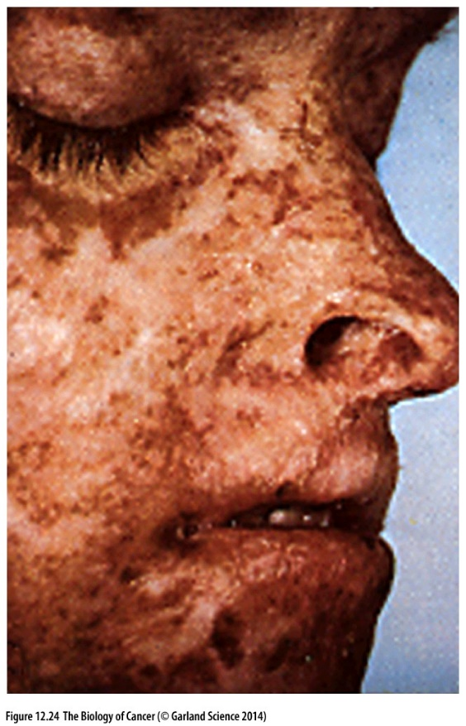
Figure 12.24 A xeroderma pigmentosum（着色性干皮病） patient A patient suffering from xeroderma pigmentosum (XP) has severe and extensive lesions in all areas of sun-exposed skin. These lesions can develop into squamous and basal cell carcinomas as well as melanomas. The tumors develop at rates that are as much as 1000-fold higher than in the general population. (Courtesy of K.H. Kraemer.)
Genetic disease with genes involved in nucleotide-excision repair

Slide 43
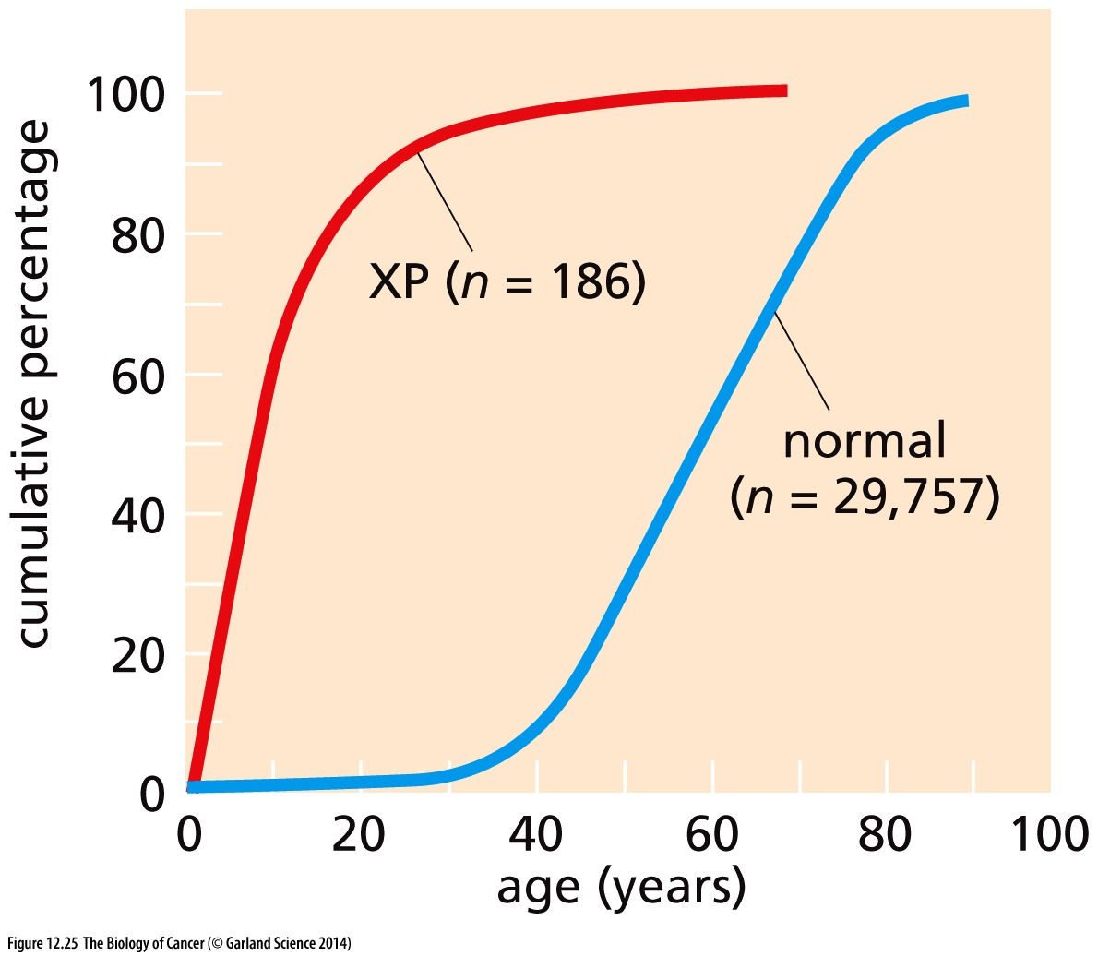
Figure 12.25 Epidemiology of XP patients
Patients suffering from
xeroderma pigmentosum (XP) exhibit
skin cancers far earlier than the general
population (normal). In the general
population, these skin cancers appear
with a median age of onset of about
60 years, in contrast to the XP
population, in which skin cancers are
diagnosed with a median age of about
10 years.

Slide 44
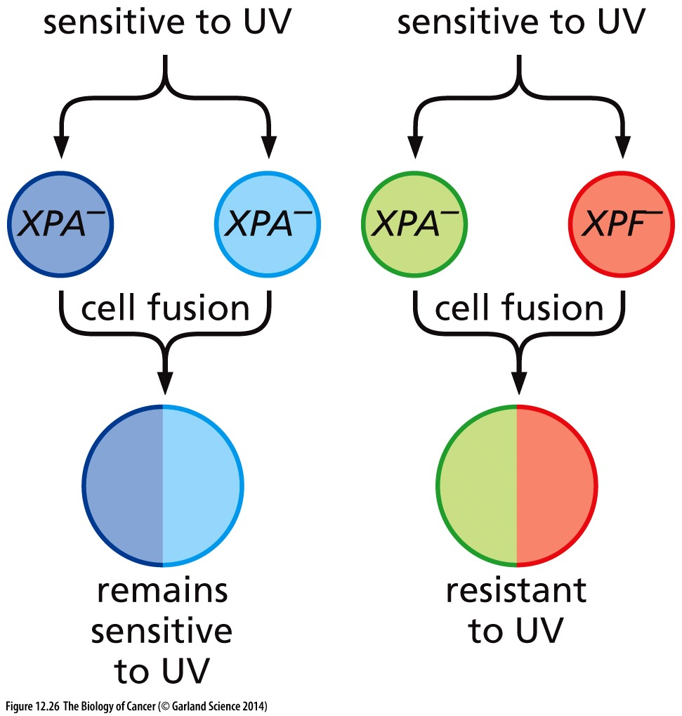
Figure 12.26 Discovery of XP complementation groups
Cell fusion experiments using cultured cells from xeroderma pigmentosum (XP) patients have revealed that certain combinations of fibroblasts, each derived from a different patient, when fused, yielded hybrid tetraploid cells that are as UV-sensitive as the two parental cell populations. On other occasions, however, fusion of cells from two patients yielded cell hybrids that are as resistant to UV-mediated killing as the cells from normal individuals. Such findings caused the pair of cells that did not complement one another’s DNA repair defect to be assigned to the same complementation group, ostensibly because the two populations carried mutations in the same gene. Conversely, successful complementation by other pairs of cells (light green, light red) allowed the respective parental cell types to be assigned to two distinct complementation groups, indicating that mutant alleles of at least two distinct genes were involved in predisposing to XP. In this way, eight distinct XP complementation groups were eventually delineated; the responsible genes were isolated by gene cloning years later.

Slide 45
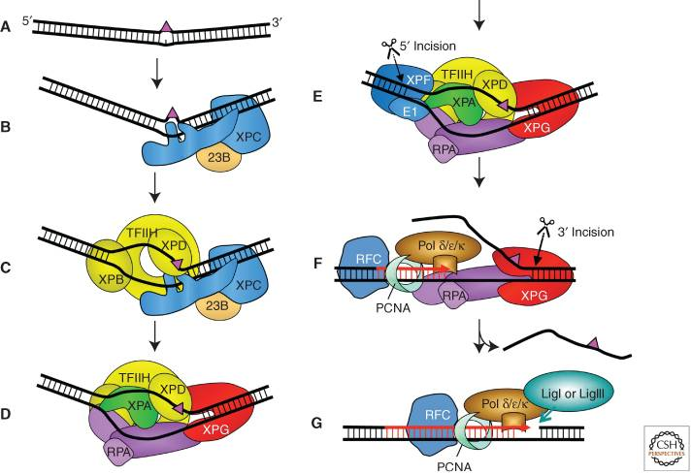
Nucleotide-excision repair

Slide 46
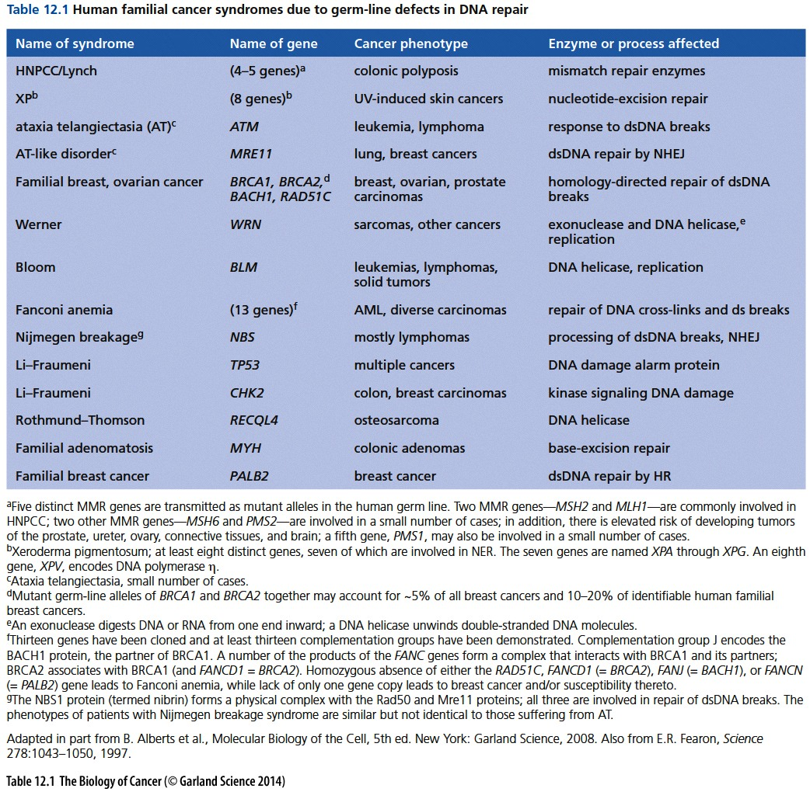

Slide 47
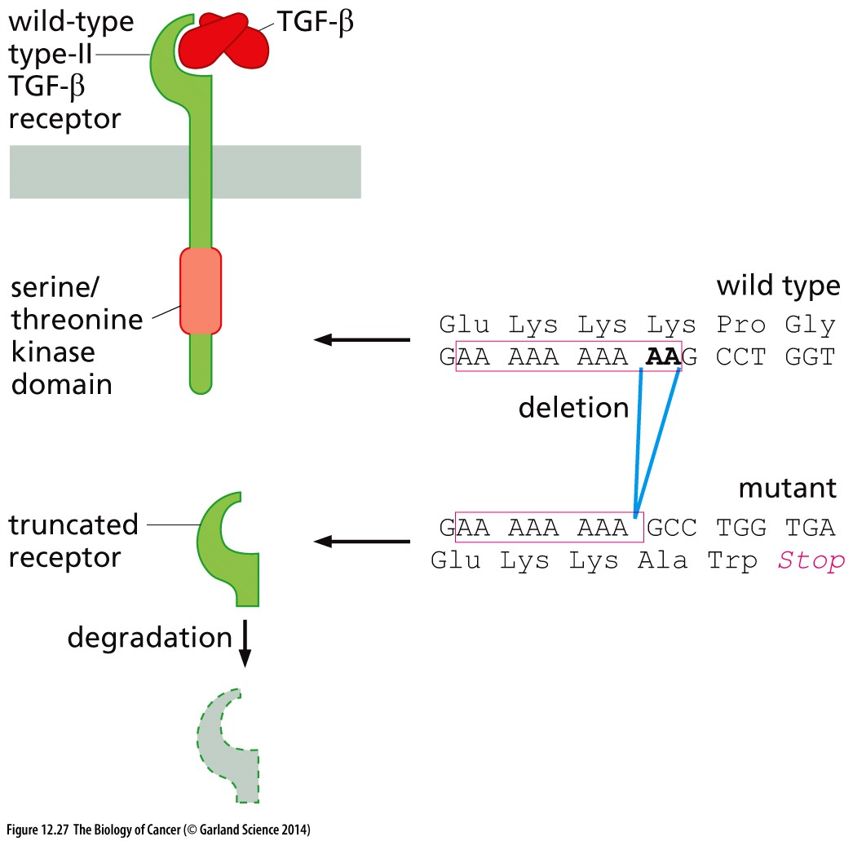
Figure 12.27 A TGF-β receptor gene
affected by microsatellite instability
Microsatellite instability

Slide 48
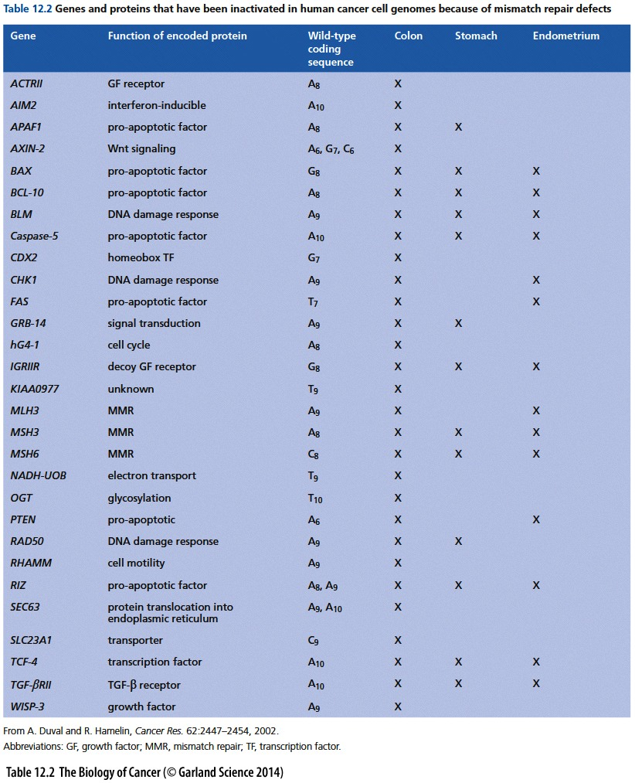
Mismatch repair defect related defects

Slide 49
By far the most notorious genes associated with cancer, at least in the mind of the
public, are BRCA1 and BRCA2. Mutant germ-line alleles of either of these genes confer
an inborn susceptibility to breast and ovarian carcinomas. For example, almost
half of all identified familial breast cancers involve germ-line transmission of a mutant
BRCA1 or BRCA2 allele; by some estimates, 70 to 80% of all familial ovarian cancers
are due to mutant germ-line alleles of BRCA1 or BRCA2. Stated differently, carriers of
mutant germ-line BRCA1 or BRCA2 alleles have a 50–70% risk of developing breast
cancer before the age of 70. Ovarian carcinoma risk is also high: 40–50% of BRCA1
mutation carriers and 10–20% of BRCA2 carriers develop disease before the age of 70.

Slide 50
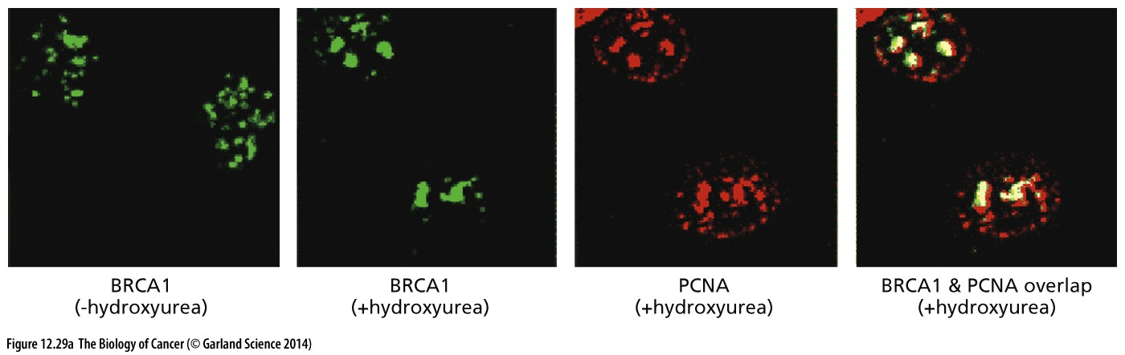
Figure 12.29 BRCA1 and the response to DNA damage
(A) The BRCA1 protein, which can be detected by fluorescence-labeled antibodies, is normally found during S phase in numerous discrete, small dots throughout the nucleus (green, 1st panel). However, when cells in S phase are treated with hydroxyurea, which stalls replication forks, the BRCA1 protein molecules leave these dots and congregate in a small number of quite large spots (green, 2nd panel). A similar relocalization pattern can be observed with the proliferating-cell nuclear antigen (PCNA), which is known to be associated with replication forks (red, 3rd panel). Substantial colocalization of the BRCA1 and PCNA is indicated by the yellow spots (4th panel); These stalled replication forks often are sites of double-strand (ds) DNA breaks caused by the accidental breakage of the still-unreplicated (and thus fragile) single-strand DNA (see Figure 12.8); these observations suggest that BRCA1 is recruited to sites of dsDNA breaks.

Slide 51
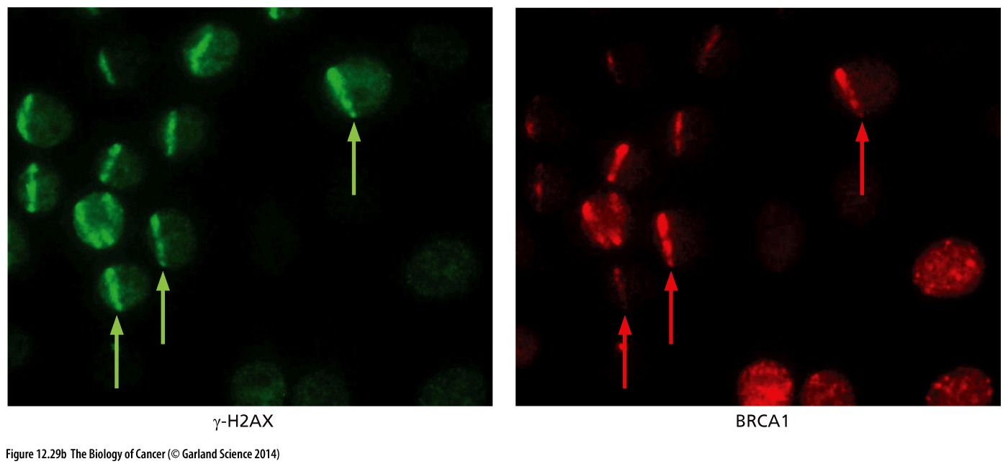
(B) A 355-nm UV laser was used to paint narrow stripes across individual nuclei, which were then analyzed by immunostaining with antibodies reactive with either γ-H2AX (a phosphorylated histone that is known to localize to chromatin flanking dsDNA breaks; green) or BRCA1 (red). This co-localization indicates that BRCA1 is attracted to areas of dsDNA breaks. (A, from R. Scully et al., Cell 90:425–435, 1997. B, from R.A. Greenberg et al., Genes Dev. 20:34–46, 2006.)

Slide 52
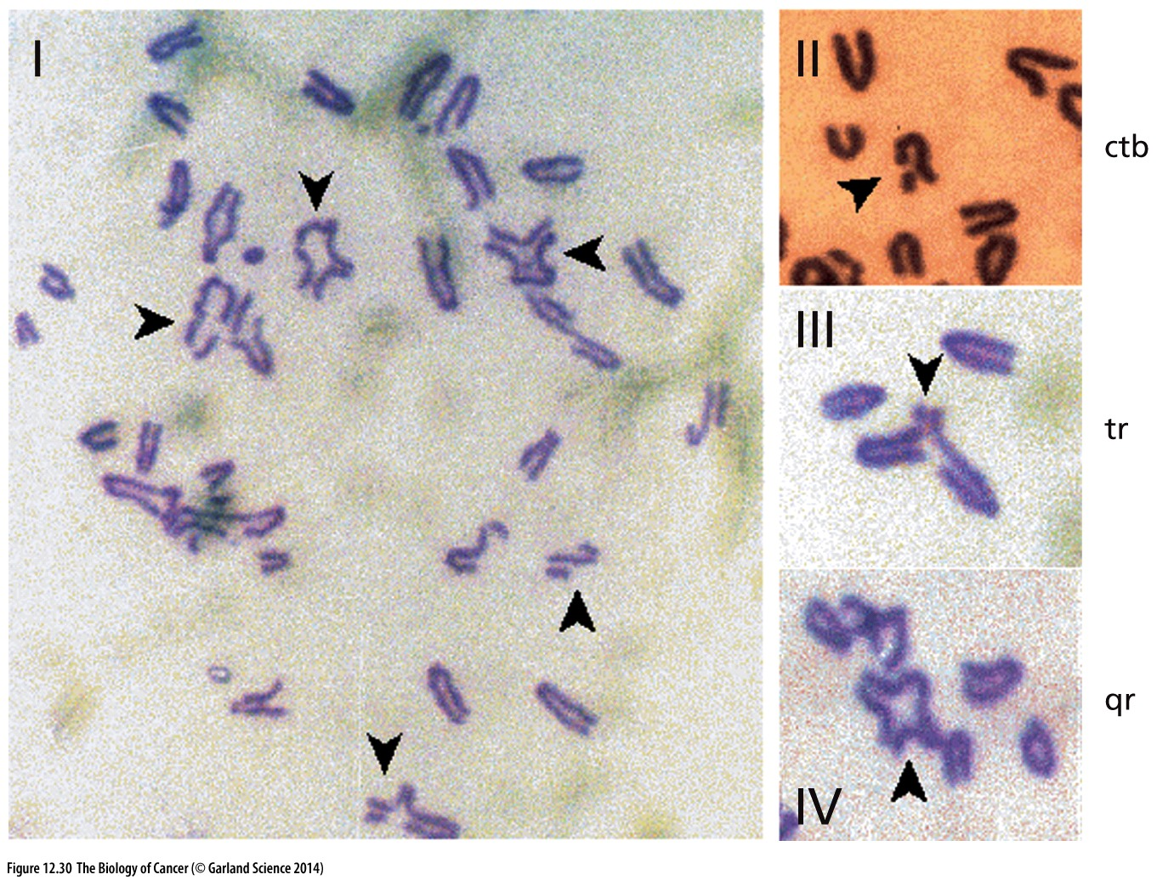
Figure 12.30 Karyotypic alterations
due to partial loss of BRCA2 function

Slide 53
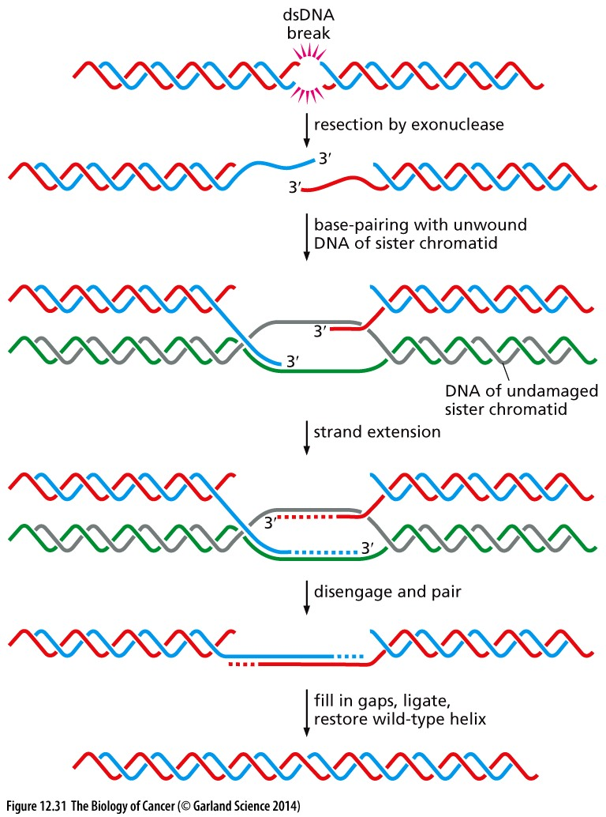
Figure 12.31 Homology-directed repair
The repair of dsDNA breaks during the late S phase and G2 phase of the cell cycle often depends on the ability of the repair apparatus to consult the sequences in the undamaged sister chromatid that was formed, together with the damaged chromatid, during the most recent S phase. Such homologydirected repair (HR) begins (top) with the resection (removal) by an exonuclease of one of the two DNA strands at each of the ends formed by a dsDNA break. Each of the resulting ssDNA strands (blue, red) then invades the undamaged sister chromatid, whose double helix (green,gray) has been unwound by the repair apparatus in order to accommodate the pairing of the invading ssDNA strands with complementary sequences in the undamaged sister chromatid. The ssDNA strands from the damaged chromatid are then elongated in a 5ʹ-to-3ʹ direction by a DNA polymerase, using the strands of the sister chromatid’s DNA as templates. Thereafter, the extended ssDNA strands are released from the sister chromatid and caused to pair with one another, allowing further elongation by a DNA polymerase and a ligase, which together reconstruct a double helix possessing wild-type DNA sequences. Included among the DNA repair proteins known or thought to facilitate these complex steps of HR are RAD51, BRCA1, and BRCA2.

Slide 54
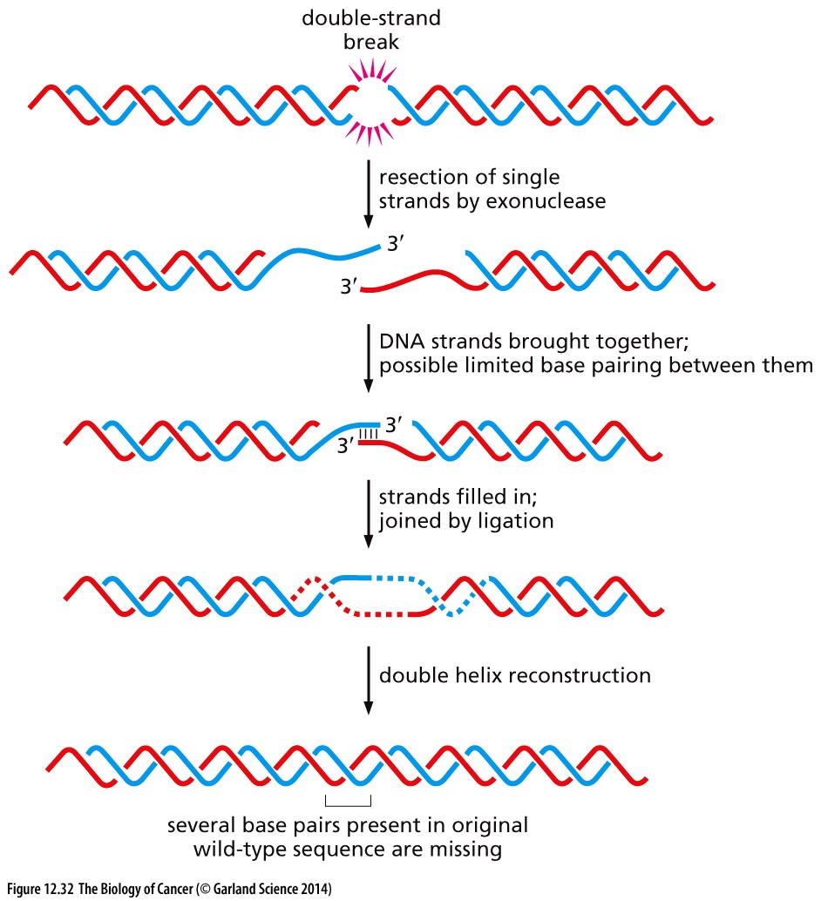
Figure 12.32 Nonhomologous end joining
NHEJ is used to restore a DNA double helix following a double-strand break when the nucleotide sequences from a sister chromatid are not available to instruct the repair apparatus how these ends should be properly joined (see Figure 12.31). In NHEJ, the resection of single strands from both broken ends results in ssDNA overhangs that can then be joined to one another, possibly by a limited degree of base pairing between them; three base pairs are shown here. The subsequent filling in of single-strand gaps and the ligation of any remaining ssDNA breaks results in the reconstruction of a double helix that lacks some of the base pairs that were present in the original undamaged DNA helix.

Slide 55
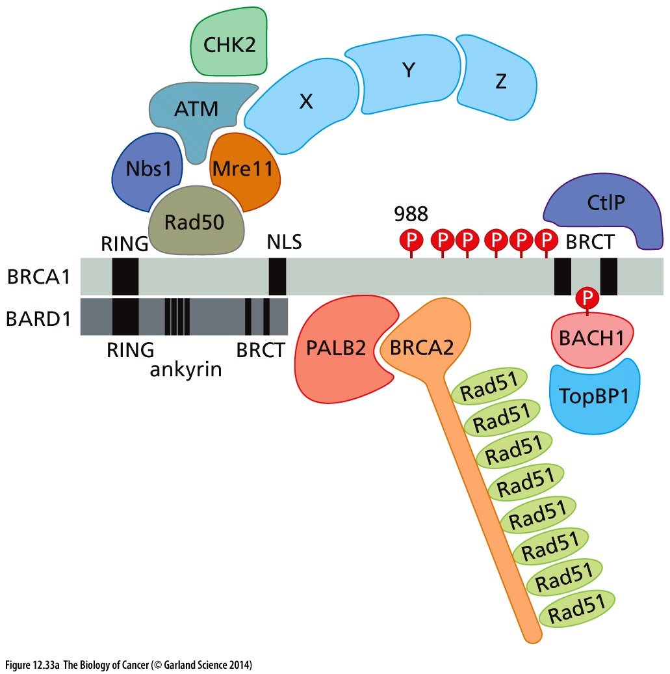
Figure 12.33 BRCA1, BRCA2, and their partners
(A) The BRCA1
and BRCA2 proteins act, at least in part, as scaffolds to assemble a
cohort of other DNA repair proteins into large physical complexes.
Once assembled, these multiprotein complexes aid in the repair
of dsDNA breaks, usually via homology-directed repair (HR). For
example, one exon of the BRCA2 gene encodes eight copies of a
“BRC domain” (not shown); these aid in the recruitment of multiple
RAD51 molecules, which form filaments and coat ssDNA strands
as part of the HR process illustrated in Figure 12.31. The MRN
complex, composed of MRE11, Rad50, and Nbs1, appears able to
recognize the end created by a dsDNA break and to activate ATM
kinase function in response. BRCA1 acts in different situations
and locales (see panel B) as a scaffold for a variety of alternative
partners, not all of which are concomitantly bound to BRCA1;
for this reason, this image depicts a single complex that never
exists in a living cell. Moreover, this image does not capture the
full complexity of BRCA1-associated proteins. For example, in the
hydroxyurea-induced nuclear spots containing stalled replication
forks (see Figure 12.29A), additional proteins have been discovered
beyond those depicted, including MDC1, RPA32, γ-H2AX, RNF8,
RNF168, 53BP1, FANCD2, and FANC1.

Slide 56
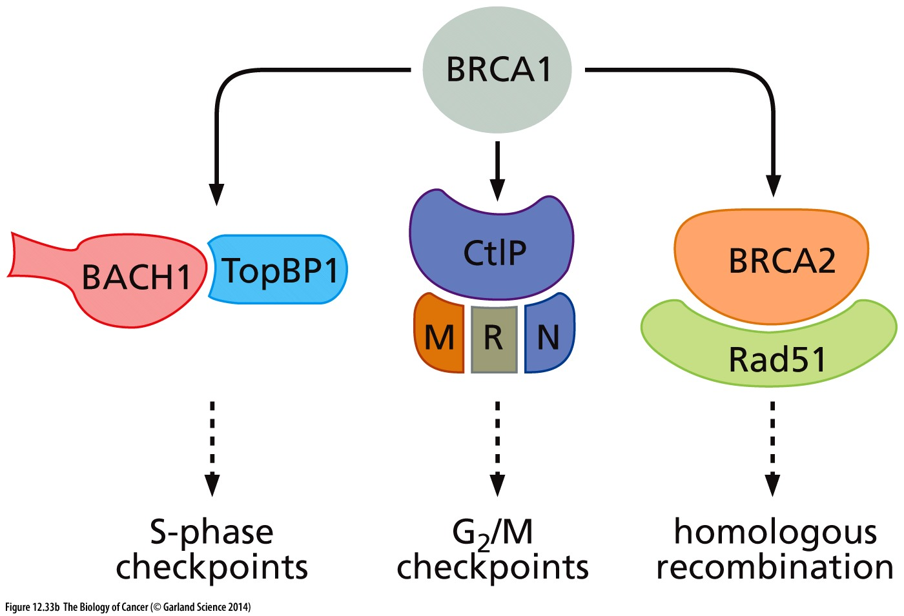
(B) The loss of different partners of BRCA1 specifically affects different checkpoint controls in the cell cycle, in addition to compromising the processes of homologous recombination and homology-directed repair (HR). This illustrates the central role that BRCA1 plays as a scaffolding for a diverse array of proteins mediating a variety of processes involving DNA function. The checkpoint controls ensure that a cell halts before either S or M phase of the cell cycle if its genome carries significant unrepaired lesions, such as DSBs (see Figure 8.4).

Slide 57
12.11 The karyotype of cancer cells is often changed through alterations in chromosome structure
Notes:
基因组复杂变异的分类与功能是我们的一个研究重点

Slide 58
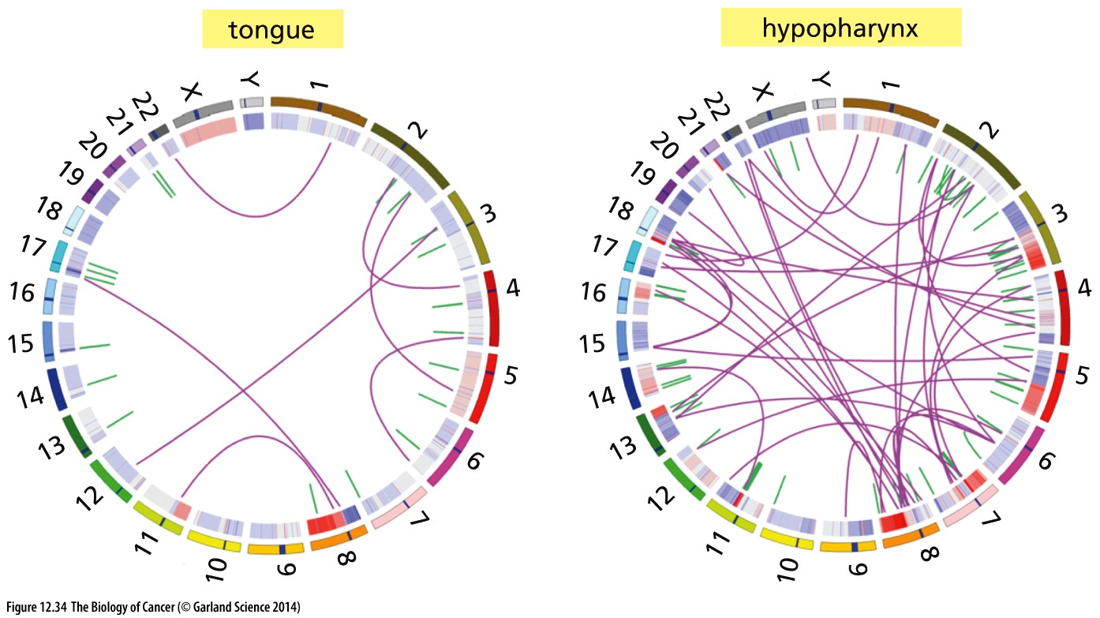
Figure 12.34 Chromosomal translocations in head-and-neck carcinomas of smokers
This graphic convention of depicting chromosomal translocations places the chromosomes around a circle according to their number or letter (sometimes termed a Circos plot) with fusions between previously unlinked chromosomal segments depicted by purple lines. Short green ticks pointing toward the center of the circle indicate regions of local intrachromosomal rearrangements, including translocations, small amplifications, deletions, and inversions. The genomes of two head and- neck squamous cell carcinomas (HNSCCs) of smokers—a tongue and a hypopharyngeal carcinoma— are depicted here. None of these translocations was associated with a recurrent translocation documented in other similar tumors.

Slide 59
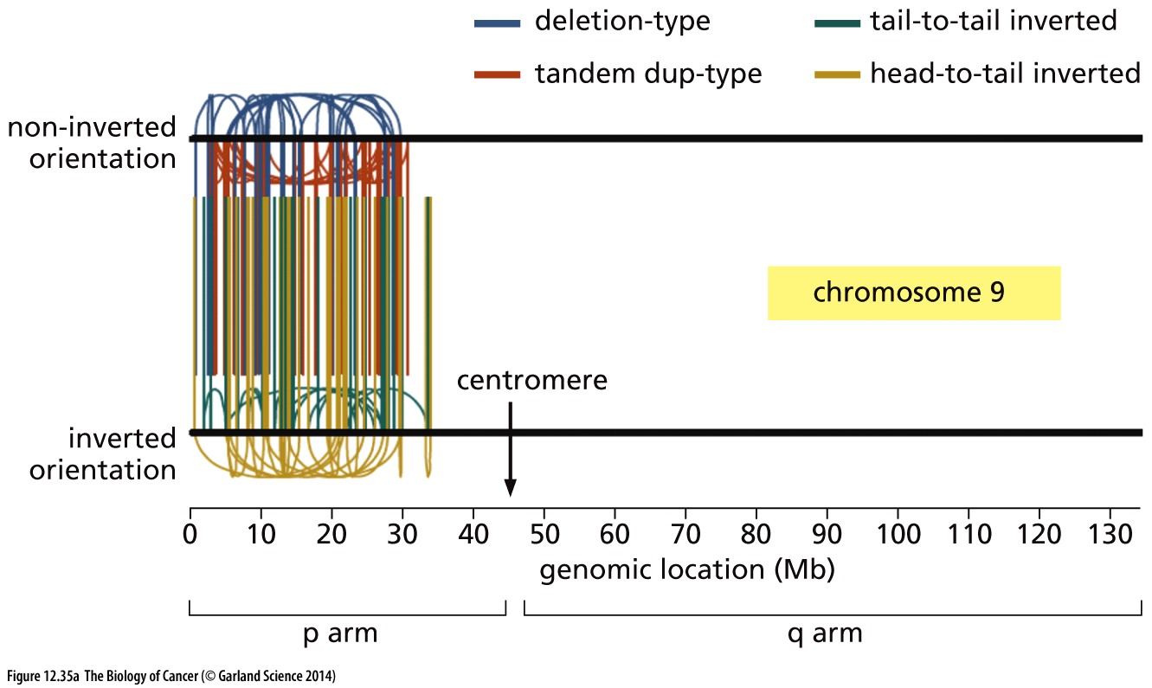
Figure 12.35 Localized firestorms of chromosomal rearrangement
The development of large-scale sequencing technologies has made it possible to discover certain types of chromosomal damage that previously eluded detection. (A) In the genome of a thyroid carcinoma, a cluster of 77 distinct chromosomal rearrangements affecting the short arm of chromosome 9 (i.e., 9p) have been documented. Each of the lines indicates the direct fusion of two DNA segments that are normally located at some distance from one another in this chromosomal arm; these rearrangements involve four distinct types of changes in DNA configuration (upper right).

Slide 60
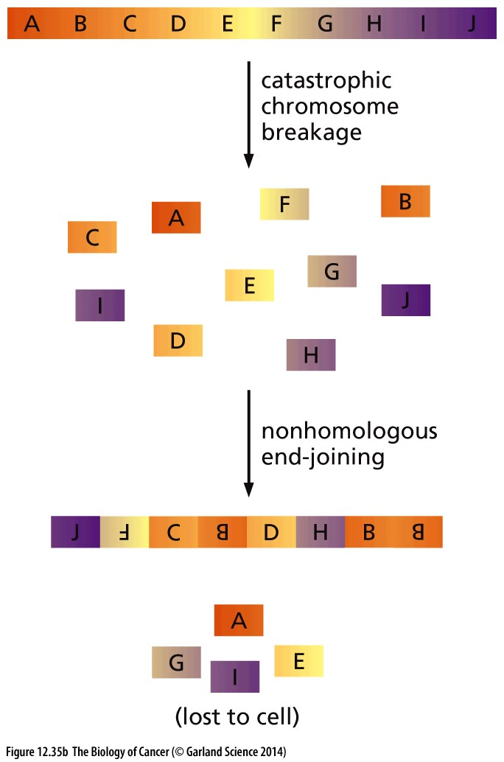
(B) This scheme provides one explanation of how this focal chromosomal rearrangement, which has been termed chromothripsis, may have arisen. The mechanism that drives this localized shattering followed by rejoining of chromosomal fragments has not been elucidated. According to one attractive model, the formation of single-chromosome-containing micronuclei (see Figure 12.38) results in individual chromosomes undergoing extensive intrachromosomal rearrangement prior to becoming reassociated with the larger complement of chromosomes during a subsequent mitosis.
Mechanism not clear

Slide 61
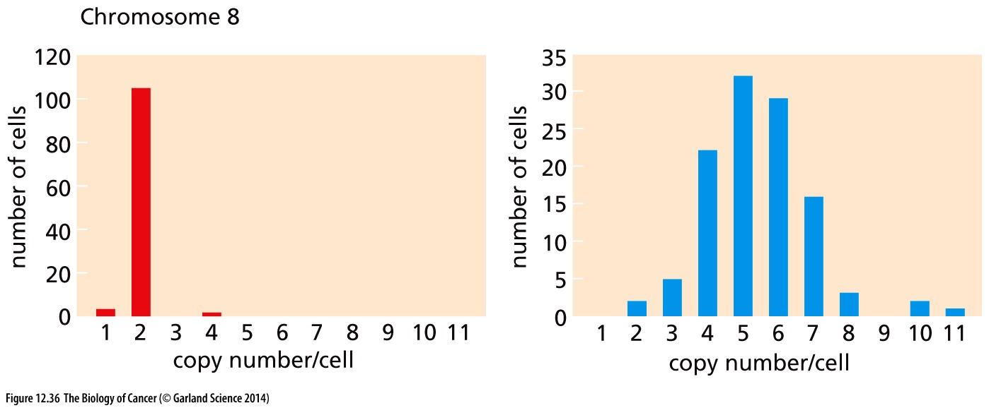
Figure 12.36 Chromosome instability in cultured cancer cells
Normal cell
Breast cancer cells

Slide 62
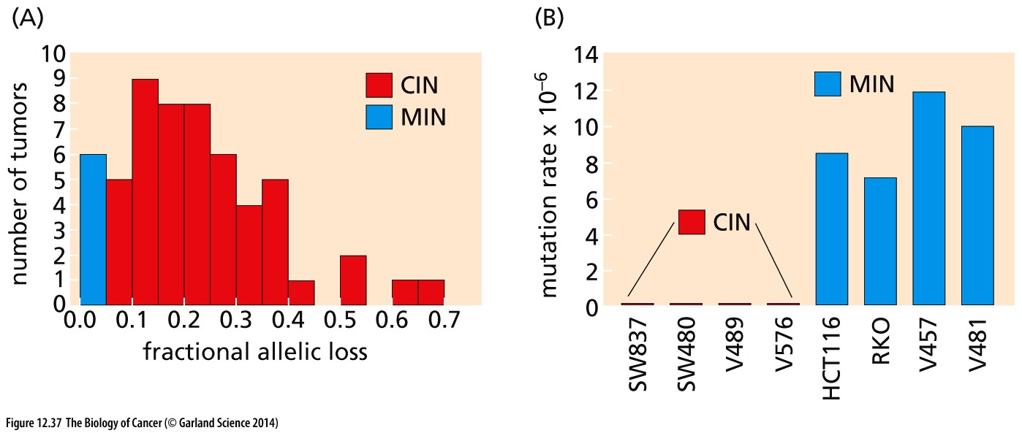
Figure 12.37 Chromosomal instability vs. gene mutation
Different mechanisms are involved in CIN vs MIN
CIN: Chromosomal instability; MIN: microsatellite intability

Slide 63

Figure 12.38 Centrosomes and the organization of the mitotic spindle
Mitotic defects can leads to aneuploidy

Slide 64

Normal cell
Breast cancer cells
(B) In these immortalized but nonmalignant interphase cells (left), the presence of a single centrosome is discernible in the cytoplasm through use of an antibody that detects pericentrin, a centrosomeassociated protein (red). This centrosome is normally duplicated at the G1/S transition to generate the two centrosomes found at the poles of the mitotic spindle. In contrast, during interphase of human breast cancer cells (right), multiple centrosomes are often observed. These will frequently create multipolar spindles (see Figure 12.39) when such cells enter mitosis.

Slide 65

(C) The pair of centrioles that forms the core of each centrosome can be best seen using transmission electron microscopy (TEM), in this case of a human colon carcinoma cell. Four centrioles are seen here in cross section (small arrows), while a side view of a fifth (large arrow) is apparent, together indicating a deregulation of centriole number. The nucleus (N) is seen above.

Slide 66

Figure 12.39 Multipolar mitotic apparatuses
In a normal mitotic metaphase of cultured cells, the spindle fibers, which are composed of microtubules, reach from the two centrosomes at the mitotic poles to the kinetochores—the multiprotein complexes that are associated with the centromeric chromosomal DNA. (A) In this micrograph of p53–/– mouse embryo fibroblasts, the formation of multiple centrosomes has resulted in a triradial mitotic spindle array. The spindle fibers have been immunostained red with an antibody reactive with α- and β-tubulin, while the chromosomal clusters have been stained blue with DAPI, a DNA dye

Slide 67

(B) The four centrosomes in this
quadriradial mitotic spindle array in
a prometaphase human fibroblast
have been stained yellow–green; the
microtubules forming the spindle fibers,red; and the chromosomes, white.

Slide 68

(C) Here, just after cytokinesis, which
follows directly after telophase (see
Figure 8.3) three daughter cells of a
human HeLa cervical carcinoma cell
line have formed from a mother cell
that ostensibly assembled a triradial
spindle during mitosis; these daughters
are trying to divide the maternal dowry
of chromosomes in three ways rather
than the usual two. Microtubules are
stained yellow; DNA is stained purple.
The abscission of these cells at the end
of cytokinesis clearly did not proceed
properly, leaving the cells connected
to one another via a chromosomal
fragment (purple dot, arrow).

Slide 69


Slide 70

Figure 12.42 Killing of BRCA2-negative cells by an anti-PARP drug
The reliance of BRCA1- and BRCA2-negative human breast cancer cells on a redundant HR pathway mediated by poly-(ADP ribose) polymerase-1 (PARP1) makes these cells especially vulnerable to killing by an anti-PARP drug. (A) PARPs constitute a family of related enzymes that act by generating repeating branched polymers of as many as 200 residues each that are attached to the PARP enzymes themselves and other proteins involved in effecting biochemical responses. In the case of PARP1, it binds to ssDNA breaks (SSBs) and ADP-ribosylates itself; its poly-ADP chains then attract a series of repair enzymes that may be ADP-ribosylated by PARP1 and thereafter proceed to complete various steps of BER.

Slide 71

(B)Such SSBs are created routinely by oxidized bases, which are usually removed by BER. Here, an oxidized base (gold) should be excised and the DNA repaired through the actions of PARP1 and recruited repair enzymes. However, in the presence of a PARP1 inhibitor, these other enzymes are not recruited, BER cannot proceed to completion, and the resulting SSB is converted to a double-strand break (DSB) when a replication fork moves through during the next S phase. This break can be efficiently restored to a wildtype configuration only through homology-directed repair (HR), which is defective in BRCA1- and BRCA2-mutant cells.

Slide 72

(C) Cultured mouse ES (embryonic stem) cells of three genotypes were treated with KU0058948, a PARP1 inhibitor. While the Brca2+/+ (blue) and Brca2+/– (green) ES cells were killed only by very high drug concentrations, the Brca2–/– ES cells were killed by the drug at concentrations almost 1000-fold lower (red).

Slide 73

Figure 12.43 γ-H2AX and double-strand DNA breaks
The creation of dsDNA breaks by various mechanisms results in the phosphorylation of H2AX histone (a variant form of histone H2A), yielding γ-H2AX. Chromosomal regions as large as a megabase that flank a dsDNA break are found to carry γ-H2AX. In the absence of H2AX, critical DNA repair proteins, including Nbs1 and Brca1 (see Figure 12.33), fail to be recruited to the site of dsDNA breaks. In the image shown here, cells of the Indian muntjac, used because of their small number of chromosomes, have been irradiated with a low dose (0.6 Gy) of X-rays.

